Slide 1

Principles of Machine Learning for Prediction
Dave Vanness, PhD
Professor of Health Policy and Administration
The Pennsylvania State University
July 31, 2019

Slide 2
If you can look into the seeds of time, and say which grain will grow and which will not, speak then unto me…
--William Shakespeare
MacBeth – Act 1, Scene 2

Slide 3
Key Learning Concepts
Iron Law of Prediction
Penalization
Cross-Validation
Parameter Tuning
Ensembles of Weak Learners

Slide 4

The Prediction Problem
Consider observed outcome Y and a set of contextual variables X.
ML practitioners often call Y a “label” (categorization) and X’s “features”
Suppose knowledge of X tells us something about the likely value of Y:
Causation: Y “listens to” X and changes in X will induce changes in Y
Correlation:
Confounding: Some other variable C, possibly unobserved, causes both Y and X
Colliding: Some other variable M is caused both by Y and X -> within a given range of M, knowledge of X will allow us to more accurately guess Y
If we wish to intervene in the “data-generating process” to change Y, correlation is not enough: we need causation (future webinar by Prof. Sherri Rose).
But suppose we win or lose based on predictions we make today to deal with Y in the future.
Planning: making sure you have enough resources on hand to meet future demands given current conditions.
How likely is a patient to select a specific treatment?
How long is this patient likely to stay in the hospital given their current status?
How likely are they to return within 30 days if we discharge them today?
How likely are they to have an adverse event requiring management?
Adjustment / Compensation: given different sets of circumstances X, is it fair to compare Y’s?
Risk adjustment in pay-for-performance contracts
Speculation: Lots of ML in the world of finance!
https://pixabay.com/photos/tarot-cards-mystic-prediction-3604473/

Slide 5


Functional Approximation
Assume a true functional relationship between features X and outcomes Y
$$Y=f\left(X\right)+ ϵ, E\left(ε=0\right),$$
$$E\left(ε^{2}\right)=σ^{2},$$
$$cor\left(X,ε\right)=0$$
Linear regression is a useful “first-order” functional approximation:
${\hat{Y}}_{i}=$ ${\hat{β}}_{0}+{\hat{β}}_{1}x_{i1}+{\hat{β}}_{2}x_{i2}+…+{\hat{β}}_{p}x_{ip}$
Math is (relatively) simple
Easy to “predict” Y given observable X’s.
Problem: simple functional approximations may generate poor predictions:
Nonlinear and discontinuous relationships among X and Y
Interactions among elements of X
May not have access to all important elements of X (missing variables)
Too many elements of X (“curse of dimensionality”)

Slide 6
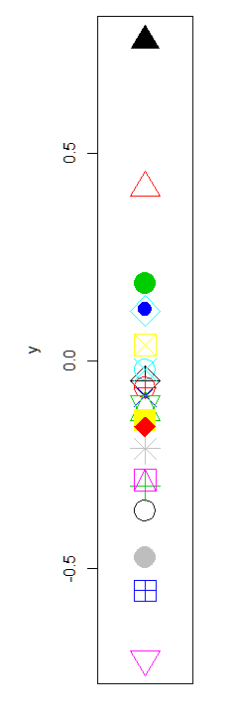
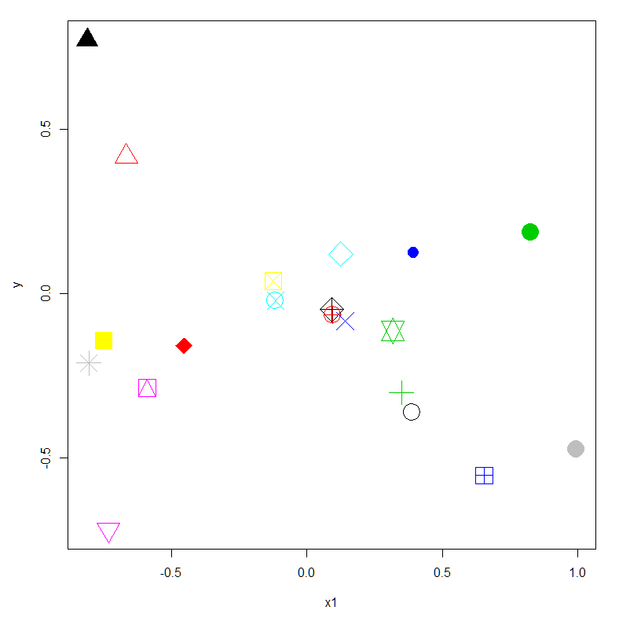
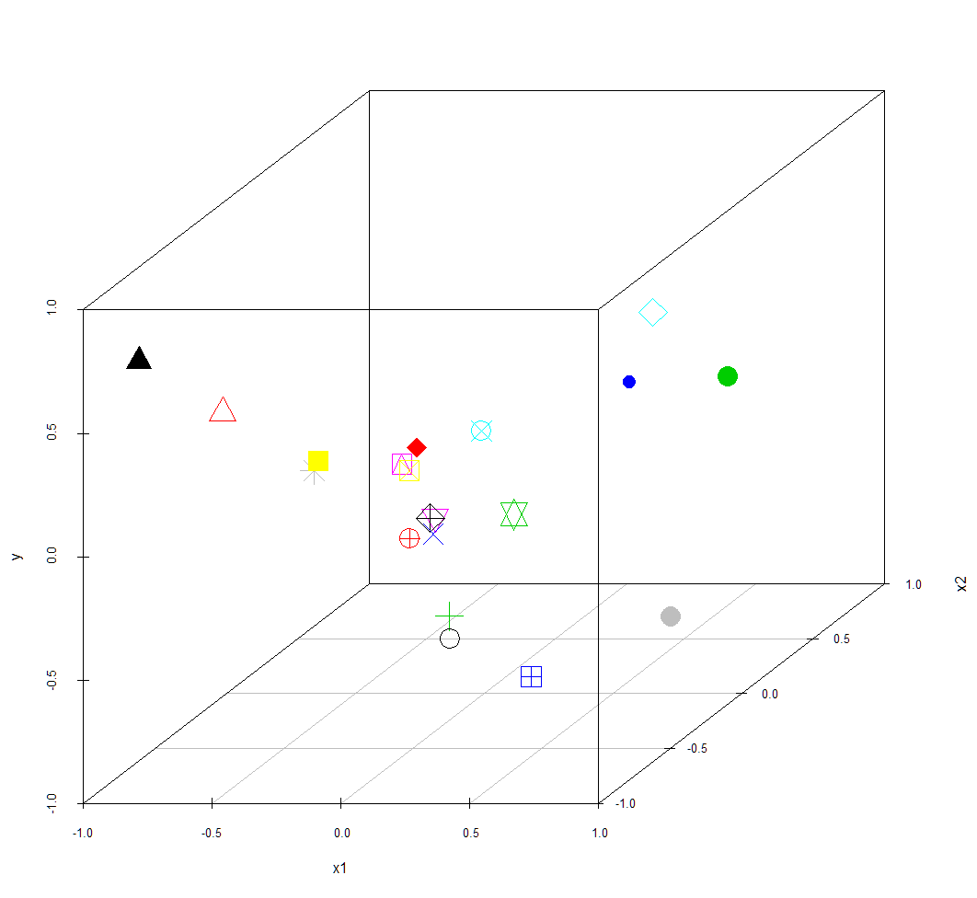
“Curse of Dimensionality”
As the number of predictors (dimensions of X) increases, any given sample’s coverage of the whole space of X becomes sparse
Observations that appear similar based on our limited view of X may actually be very dissimilar
If we “broaden our view” to produce general predictions applicable across the whole space of X, say by fitting a line or a (hyper-)plane, we will systematically over-predict or under-predict (bias) for some subsets of X.
If we “narrow our view” to produce very specific predictions tailor-made for subsets of X, those estimates may jump around substantially from sample to sample.

Slide 7
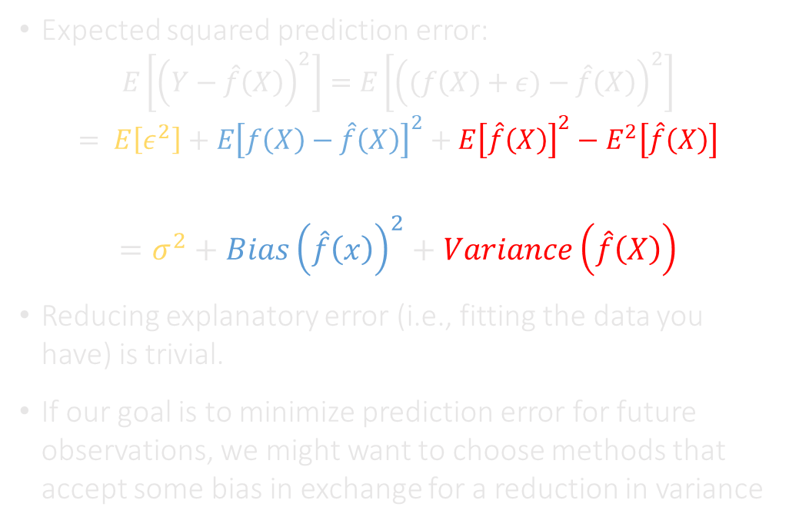
The Iron Law of Prediction
Expected squared prediction error:
$$E\left[{\left(Y−\hat{f}\left(X\right)\right)}^{2}\right]=E\left[{\left((f\left(X\right)+ε)−\hat{f}\left(X\right)\right)}^{2}\right]$$
$$= E\left[ε^{2}\right]+E{\left[f\left(X\right)−\hat{f}\left(X\right)\right]}^{2}+E{\left[\hat{f}\left(X\right)\right]}^{2}−E^{2}\left[\hat{f}\left(X\right)\right]$$
$$=σ^{2}+Bias{\left(\hat{f}\left(x\right)\right)}^{2}+Variance\left(\hat{f}\left(X\right)\right)$$
Reducing explanatory error (i.e., fitting the data you have) is trivial.
If our goal is to minimize prediction error for future observations, we might want to choose methods that accept some bias in exchange for a reduction in variance
Higher Bias
Low Variance
Lower Bias
High Variance
Future Observations
Expected Error
Training Sample
Irreducible Error σ²
Low
Model Complexity
High
Adapted from Hastie, Tibshirani and Friedman Elements of Statistical Learning, 2001, p. 38

Slide 8
"Prediction is very difficult, especially if it's about the future."
--Niels Bohr

Slide 9
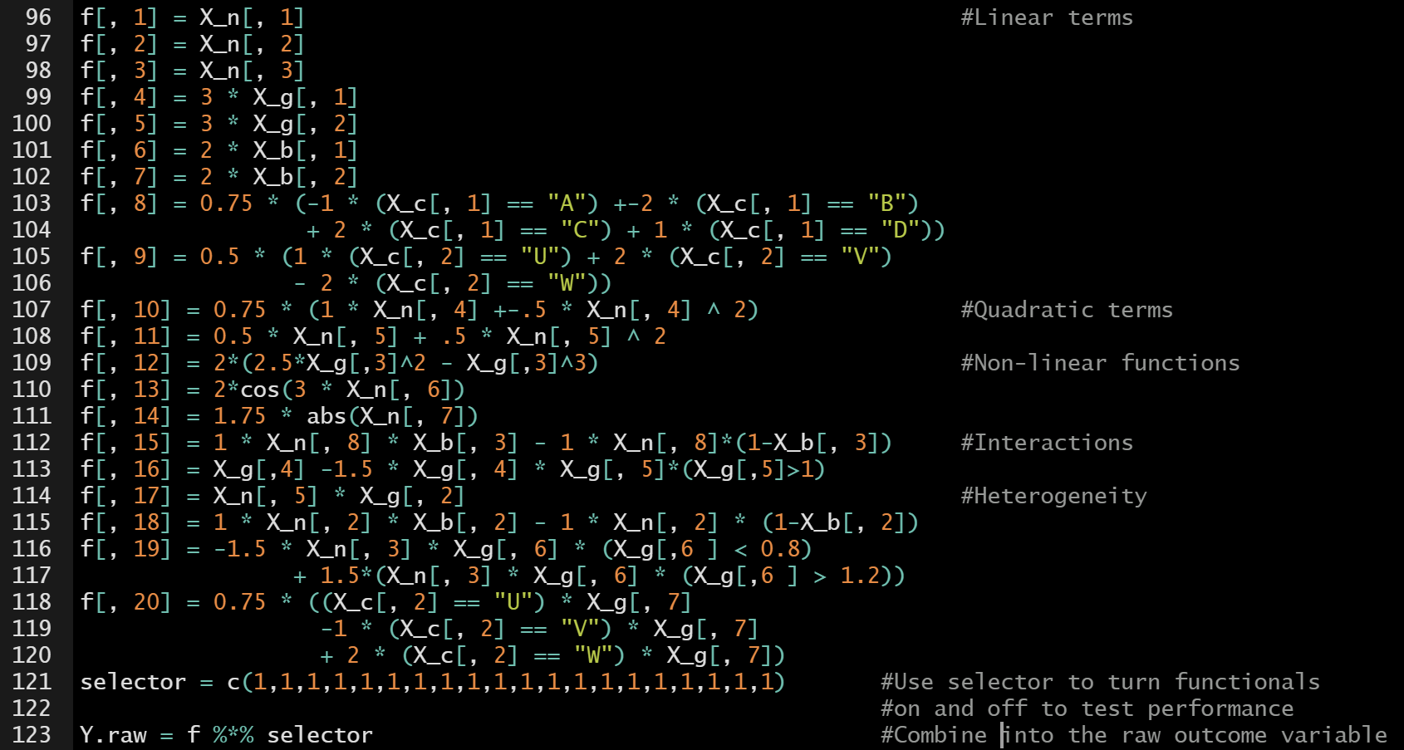
A simulated dataset
To demonstrate different machine learning approaches, we will be using a simulated dataset.
Continuous composed of linear, non-linear and interactions of 20 observed predictors.
20 “false target” predictors also included.
“Training” set of 2,000 observations: used to build models.
“Validation” set of 98,000 observations used to measure predictive performance.

Slide 10
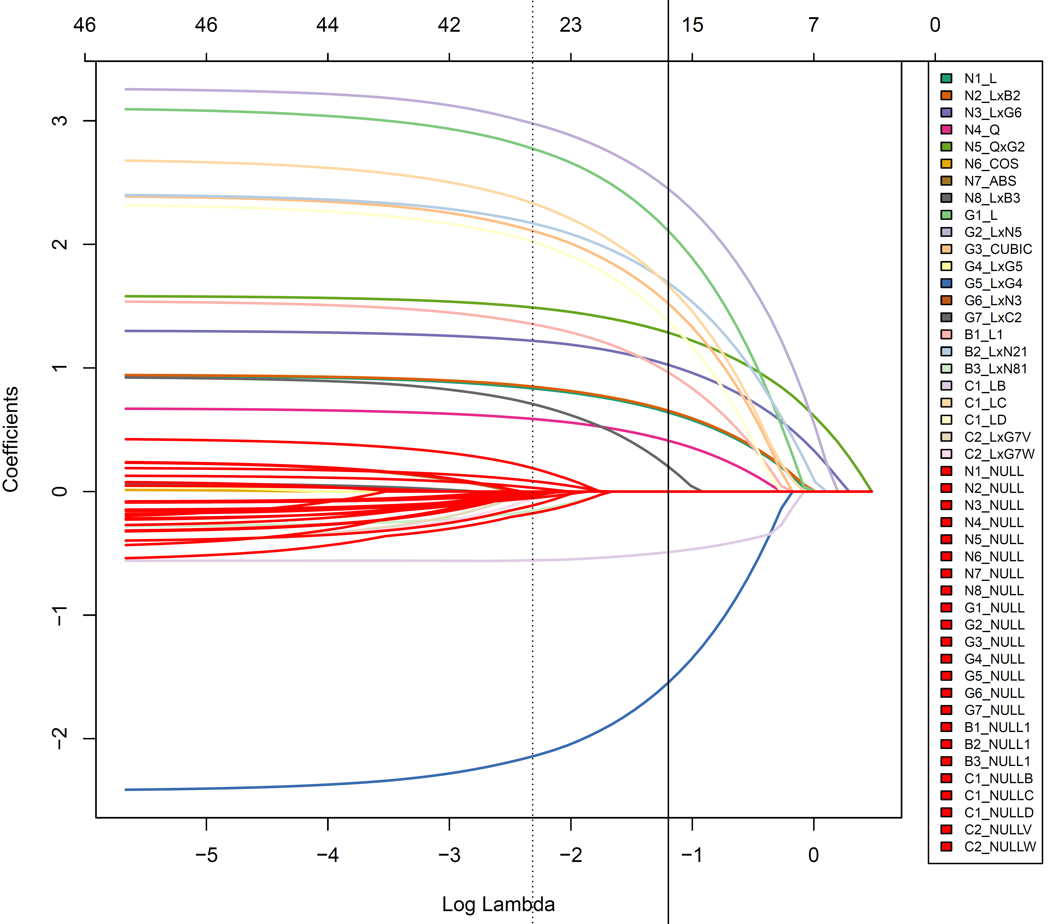
Penalization: the LASSO
MLE Estimate
Simulated Data Example
In Least Absolute Selection and Shrinkage Operator (LASSO) regression, the least squares argument contains a penalty function on the absolute value of the slope coefficients.
$${\hat{β}}_{Lasso}= \underset{β}{argmin}\left\{\sum_{i=1}^{N}{{\left(y_{i}−β_{0}−\sum_{j=1}^{p}{x_{ij}β_{j}}\right)}^{2}}+λ\sum_{j=1}^{p}{\left|β_{j}\right|}\right\}$$
𝛽 ̂_𝐿𝑎𝑠𝑠𝑜= argmin┬𝛽⁡{∑_(𝑖=1)^𝑁▒(𝑦_𝑖−𝛽_0−∑_(𝑗=1)^𝑝▒〖𝑥_𝑖𝑗 𝛽_𝑗 〗)^2 +𝜆∑2_(𝑗=1)^𝑝▒|𝛽_𝑗 | }
Increasing the penalty parameter λ causes slope estimates of covariates with low explanatory power to “shrink” toward zero and eventually exit the model.
Note: hypothesis testing on β is no longer valid
Trades an increase in prediction bias for a decrease in prediction variance
How far should we go?
R package:
glmnet

Slide 11
Tuning Models through Cross Validation
Complexity penalties like λ can be “tuned” to balance tradeoff between complexity vs. parsimony, bias vs. variance, etc.
N-fold cross-validation illustrates this tradeoff by creating a sample analogue to the iron law of prediction reserving part of the dataset as a test set
N-fold Cross Validation:
Start with penalties/constraints set to give the most parsimonious model
Designate 1/Nth of the sample as a test set and the remaining (N-1)/Nths as the training set
Estimate the model on the training set and calculate mean-squared prediction error on the test set
Repeat steps 2-3 to generate N complete “folds” and average to create the “cross-validation mean-square error” (Xerror) and its standard error
Relax the penalties/constraints to increase the complexity of the model and repeat steps 2-4
After repeating to maximally complex model, examine Xerror as a function of the penalty/constraint values
“1 S.E. Rule of Thumb” – choose the penalty/constraint that generates the least complex model with Xerror not more than the minimum Xerror (plus 1 standard error)
Fold 1
Train
Test
Fold 2
Test
Fold 3
Test
Calculate
Xerror
Fold 4
Test
Fold 5
Test

Slide 12
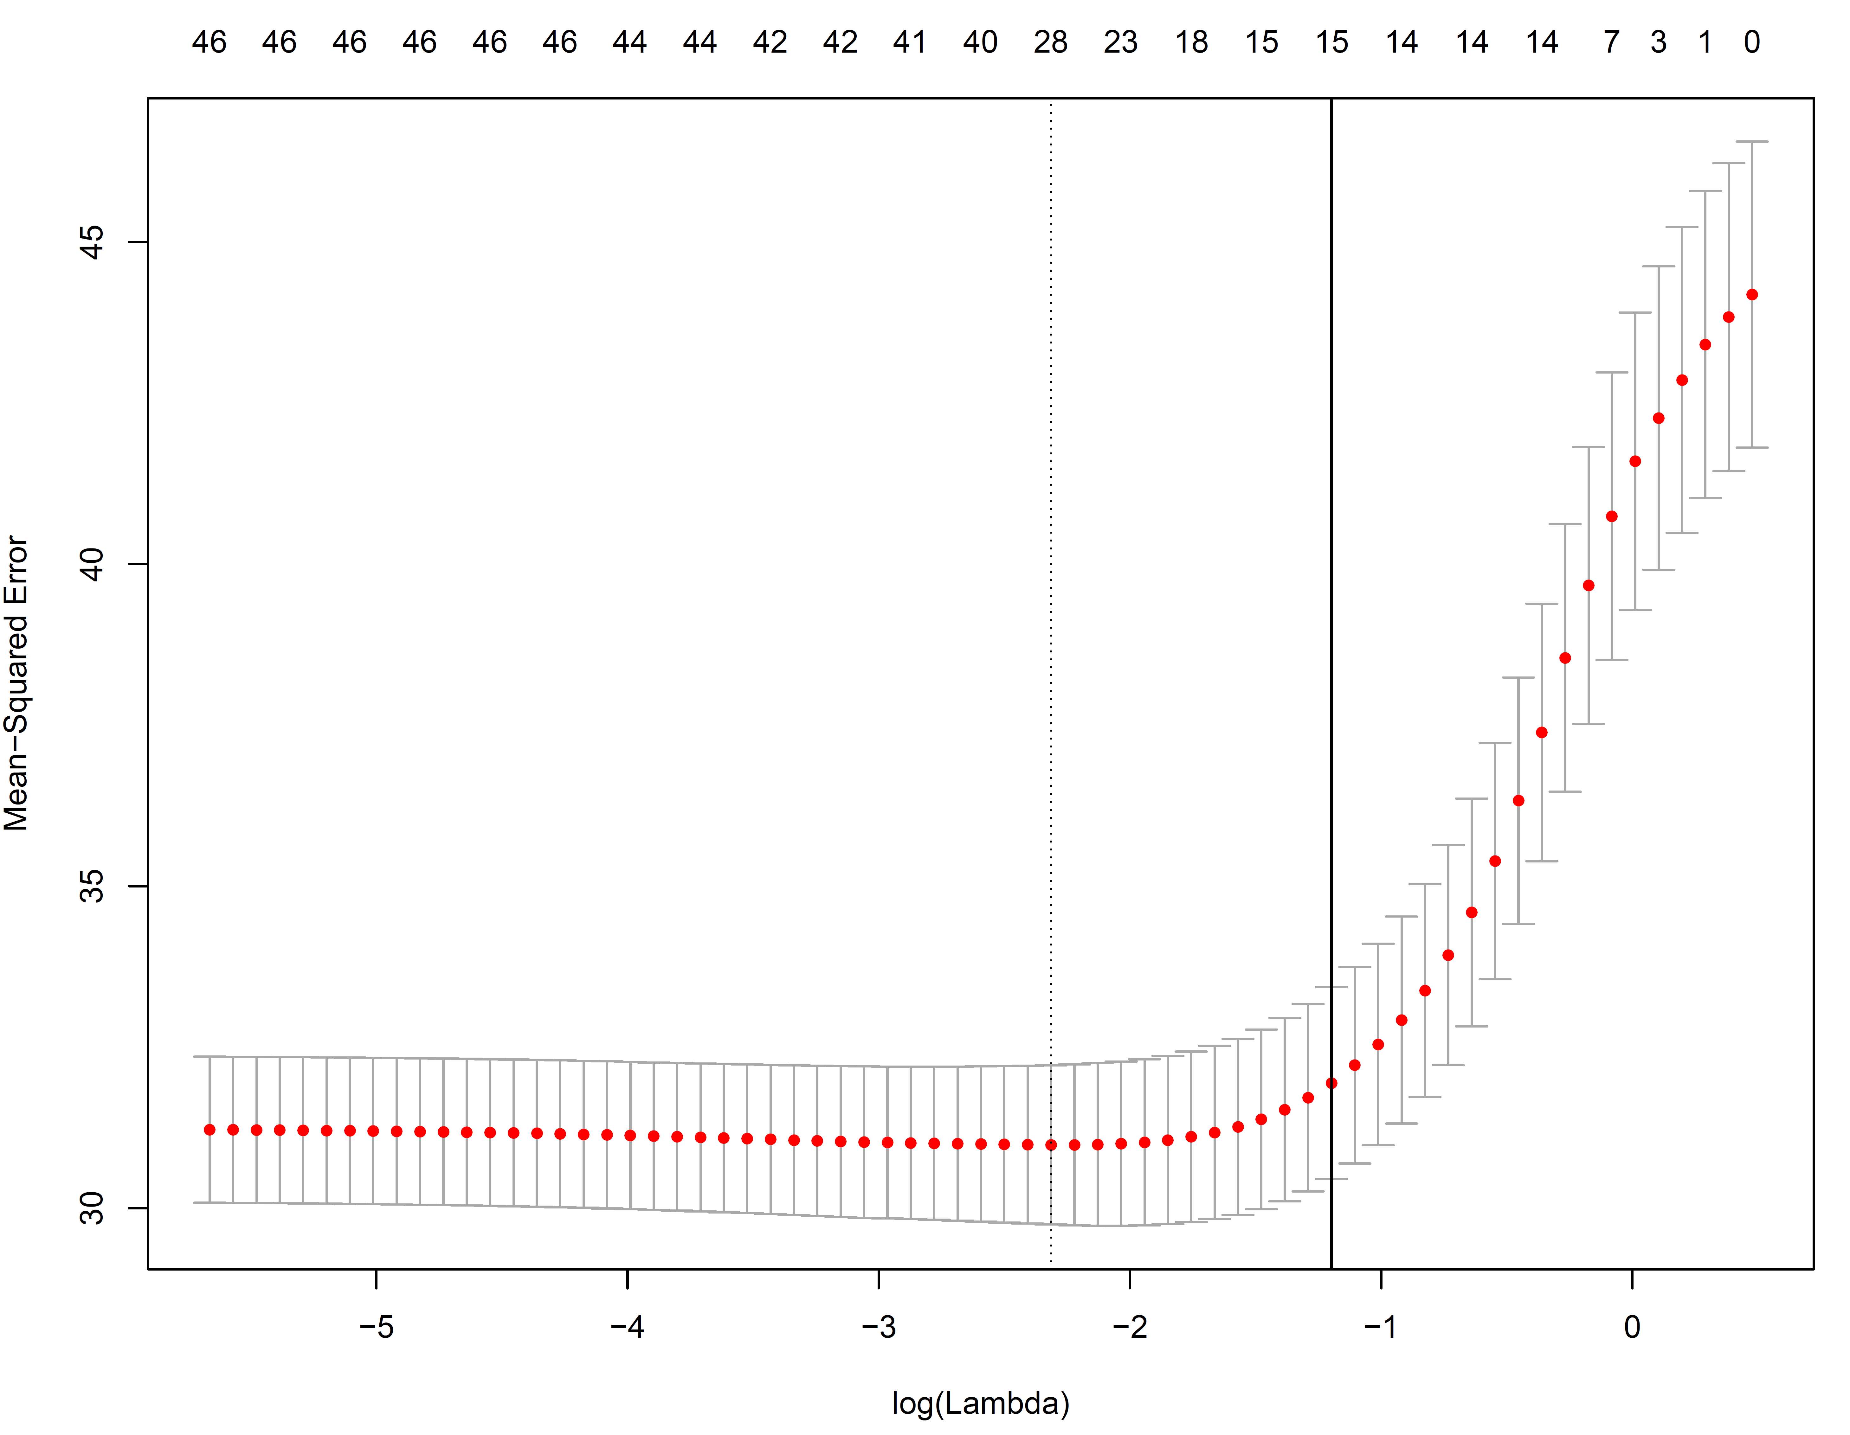
MLE Estimate
1-SE Optimal CV Model
Note: Model complexity
decreasing
Minimum Xerror Model
Complexity Increasing

Slide 13

MLE Estimate
1-SE Optimal CV Model
Minimum Xerror Model
Complexity Increasing
Note: None of these 20 variables were in the equation generating the simulated outcome data

Slide 14
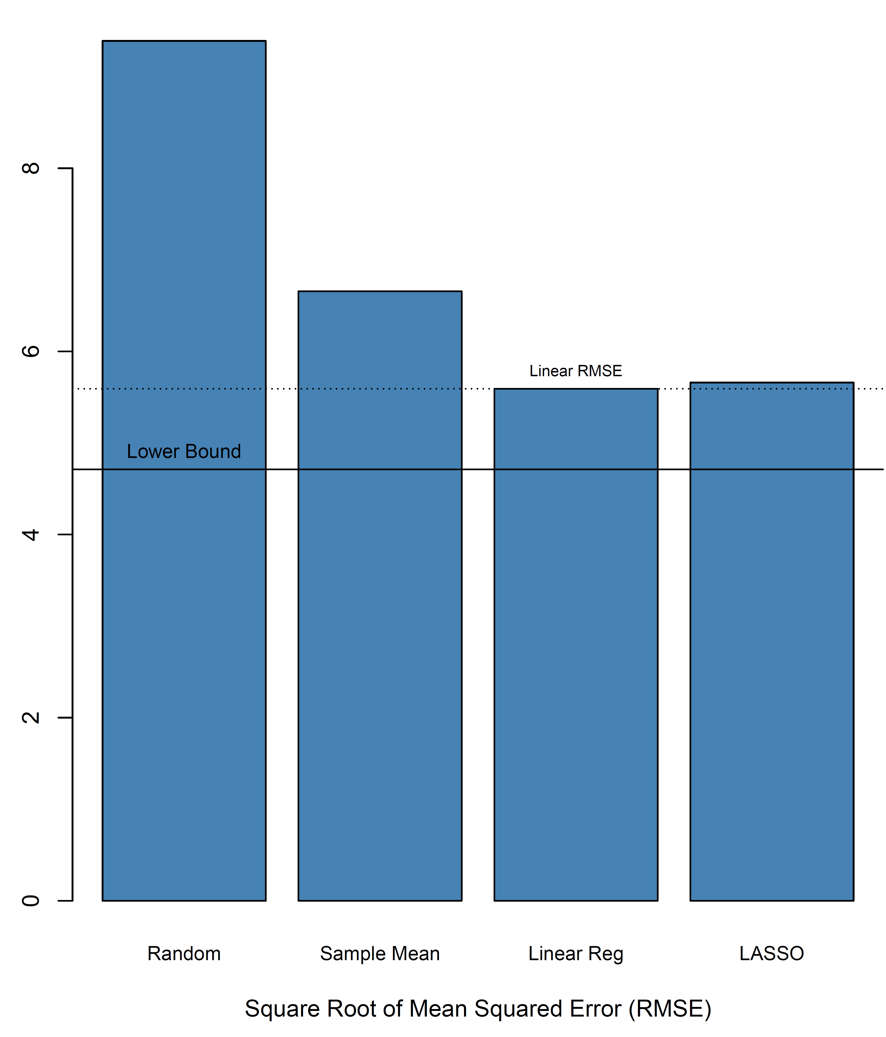
Comparing Performance
LASSO actually performed a little worse than linear regression!
Why?
Only about half of the predictors were false targets
Relatively large sample size means linear regression predictions are fairly stable

Slide 15

“All our wisdom is stored in the trees.” – Santosh Kalwar
https://crh.dev/TreeGenerator/index.html

Slide 16
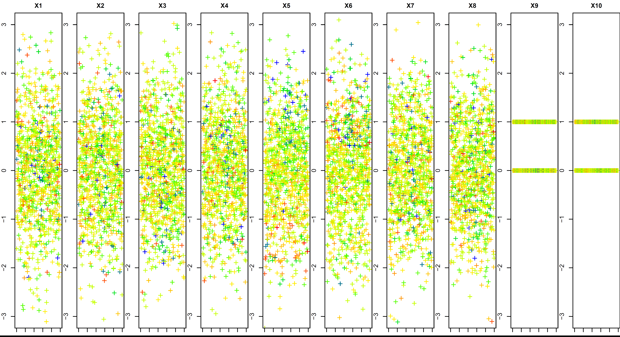
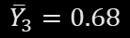

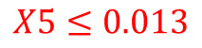
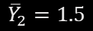
The algorithm finds a cut-point for each predictor that splits the training sample into two subgroups (nodes) that as different as possible from one another in the outcome
Then selects the predictor that produces the largest reduction in heterogeneity
Because it seeks the best split and selects the best variable, we call this a “greedy” algorithm
$${\overline{Y}}_{1}=1.0$$
Recursive Partitioning
(Classification and Regression Trees)
$${\overline{Y}}_{3}=0.68$$
$$X5≤0.013$$
$${\overline{Y}}_{2}=1.5$$

Slide 17
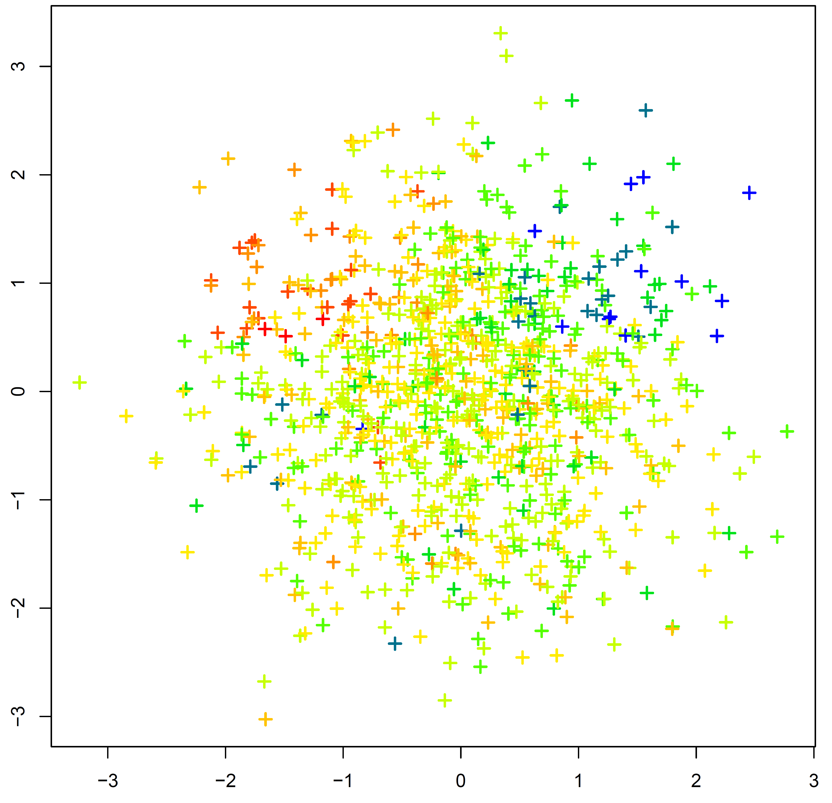
Too Small?
The algorithm proceeds recursively by finding the best splits and best variable for each subgroup (child node) created in the previous step
R package:
rpart,
rpart.plot
X6
0.018
2.4
1.0
1.1
X5

Slide 18
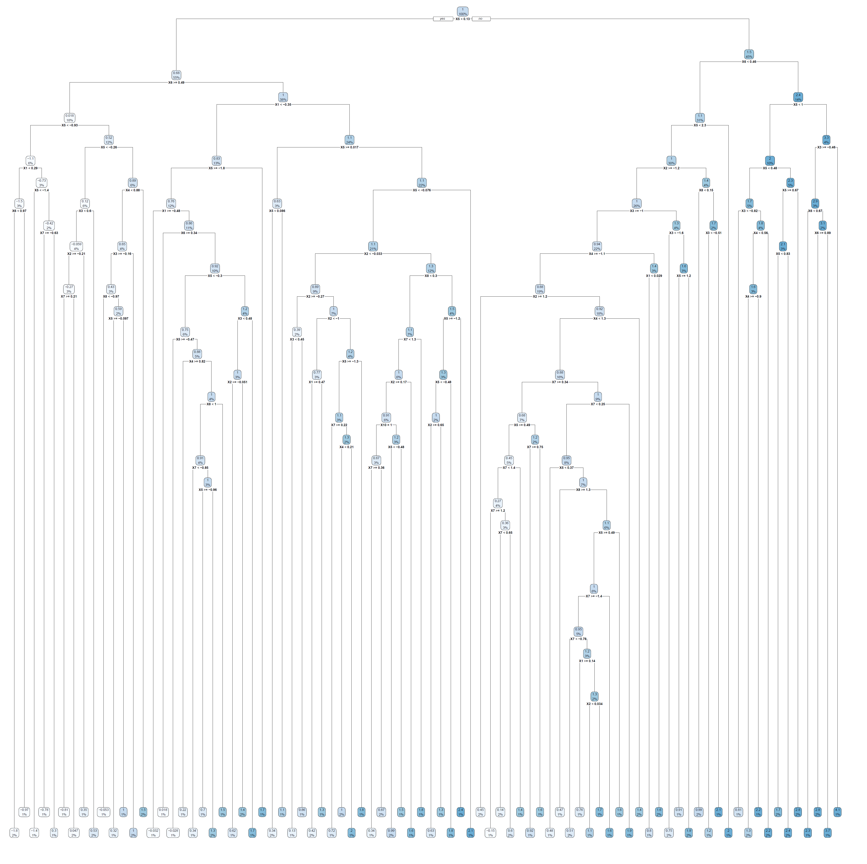
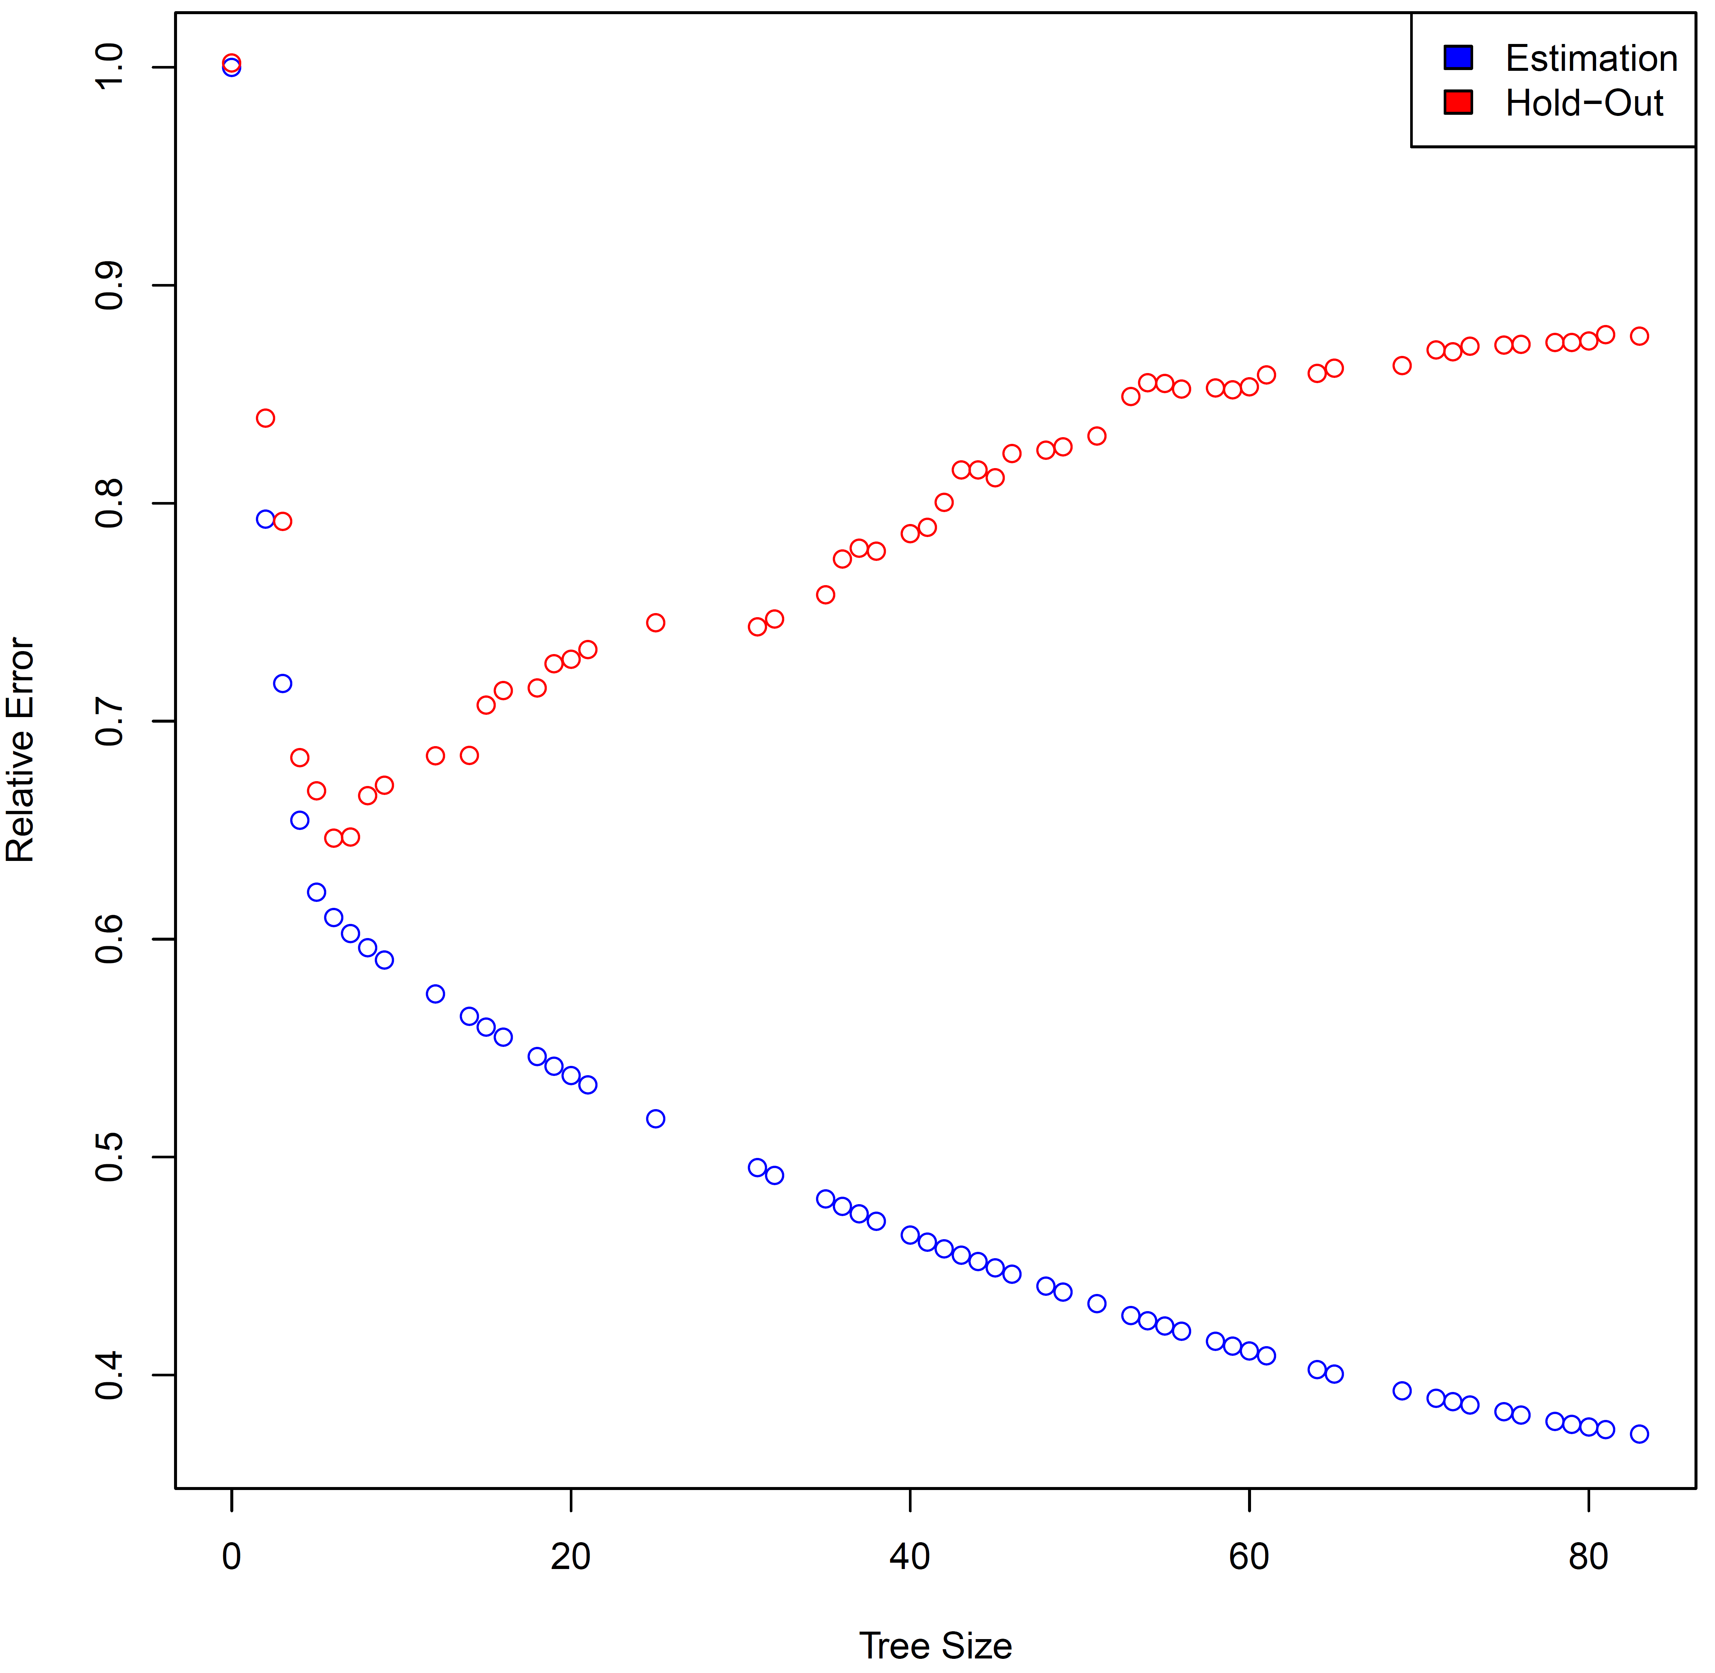
Too Big!!!
The Iron Law of Prediction in Action!
10-fold Cross-Validation

Slide 19
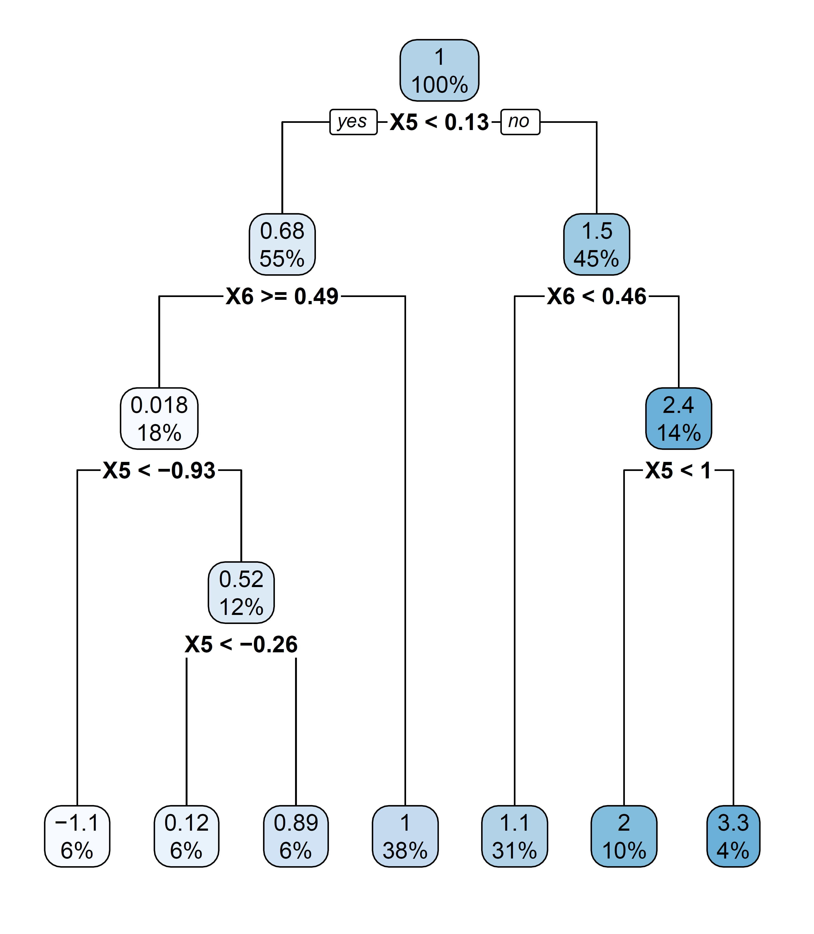

Just Right!

Slide 20
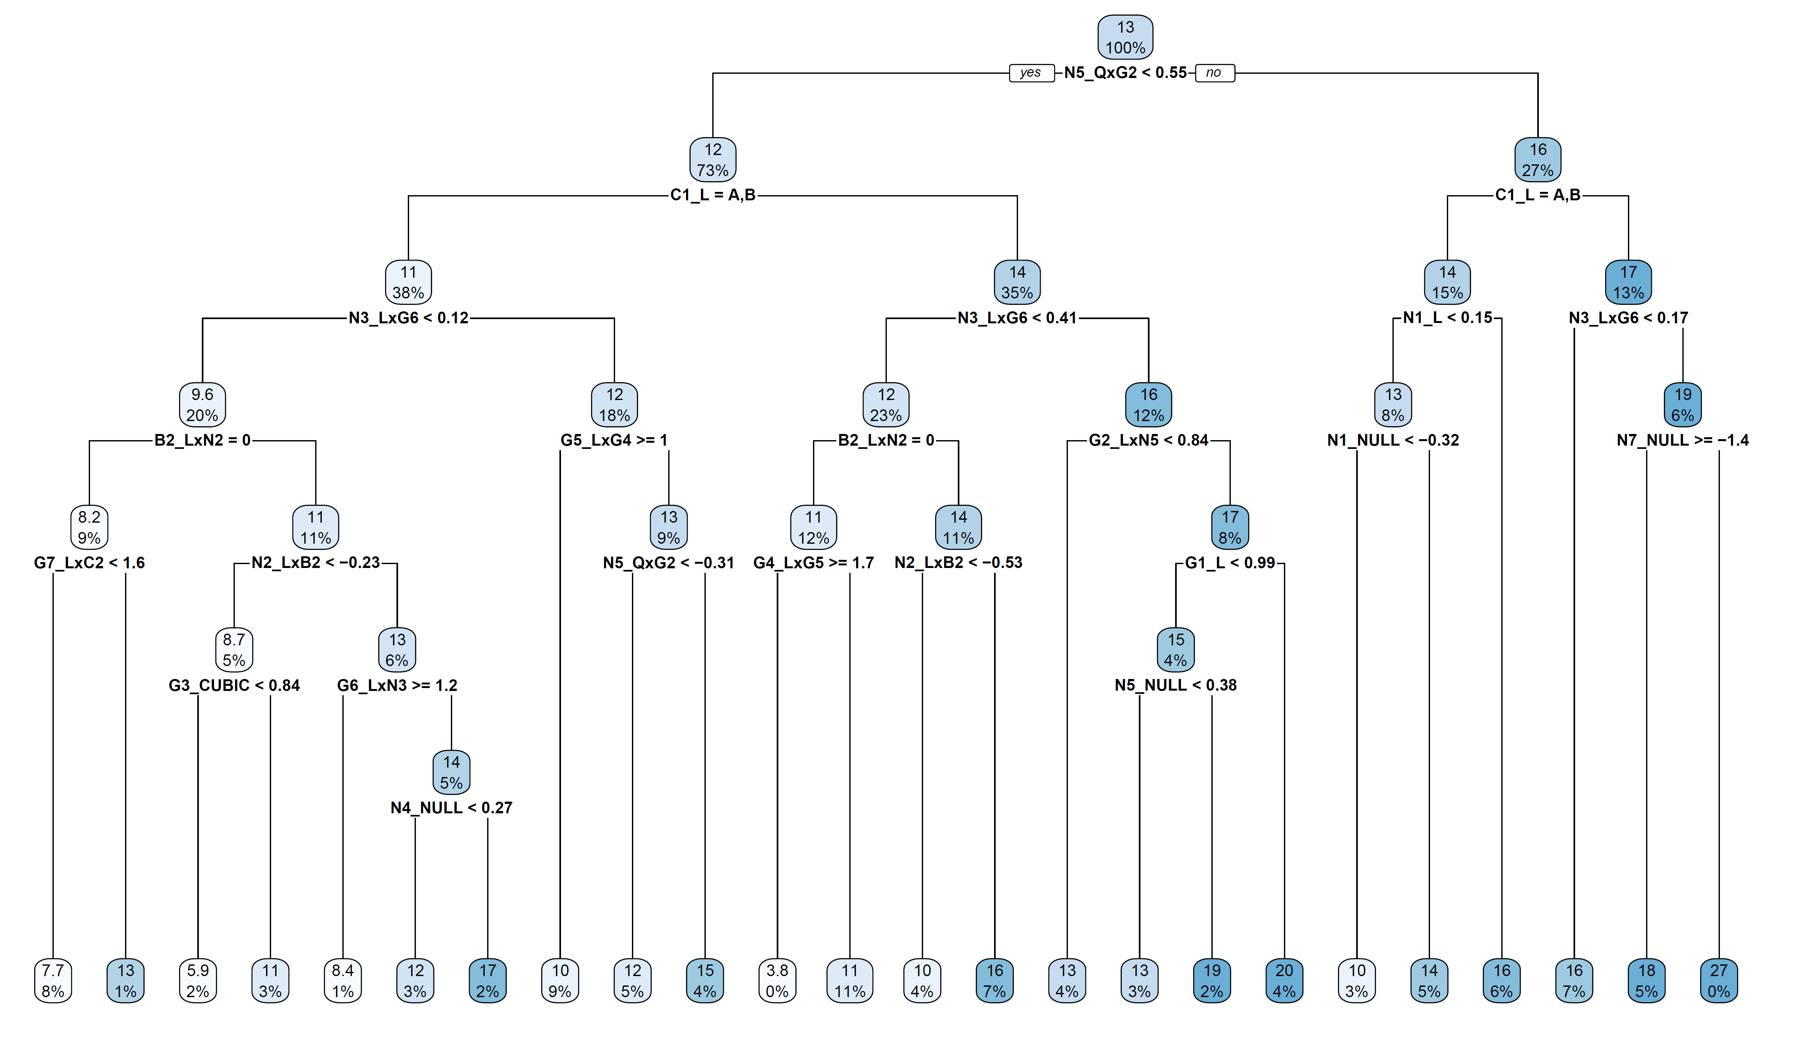
Back to our main simulated data example…
High potential for sensitivity to small clusters of observations
The fully grown tree almost certainly overfits the training data at the expense of predictive error out of sample

Slide 21
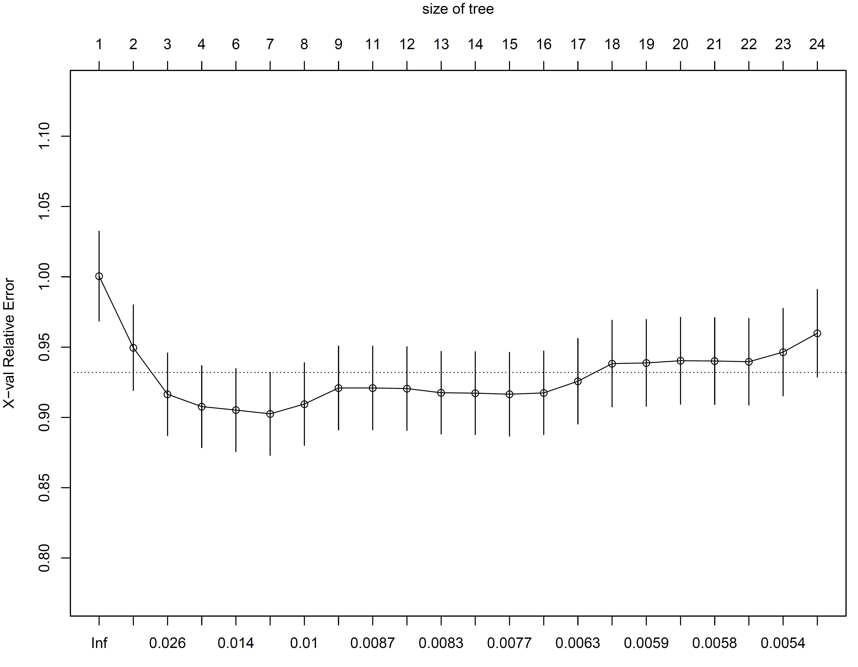
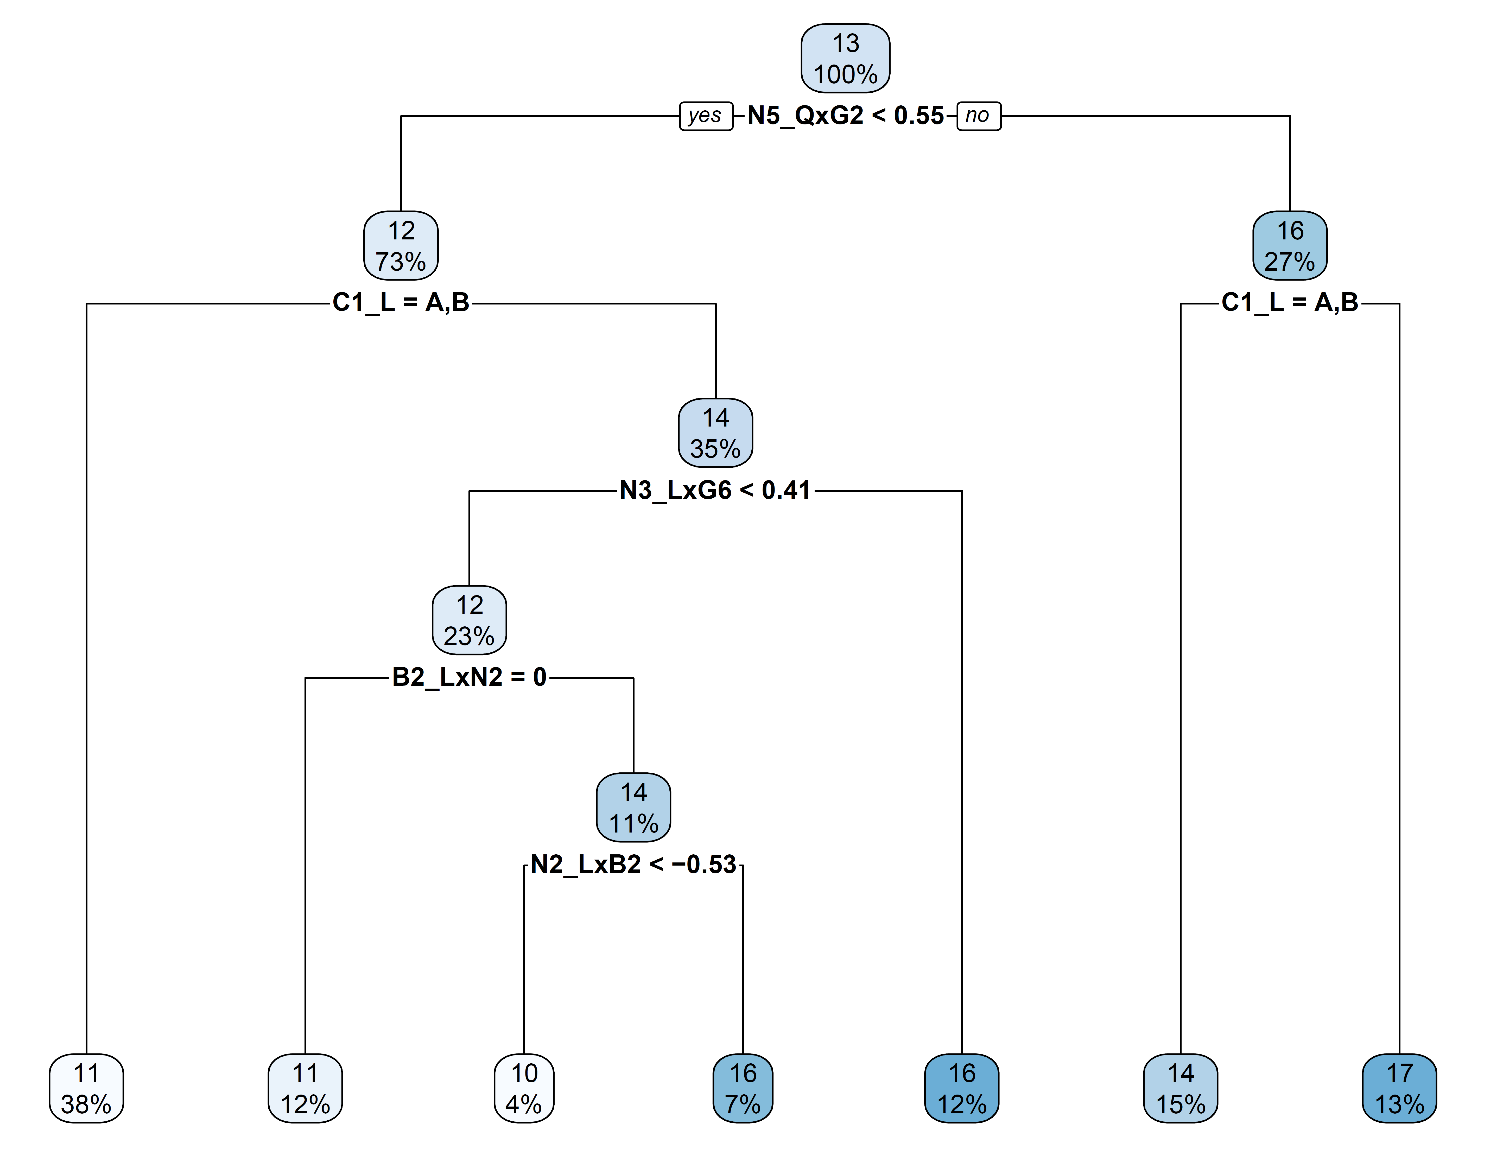
Back to our main simulated data example
We performed 5x-repeated 5-fold cross-validation…
Trees resulting from more restrictive complexity parameters are said to be “pruned”
The pruned tree at left generates 7 “terminal nodes” (or leaves) that partition the dataset and generate 7 possible predicted values

Slide 22

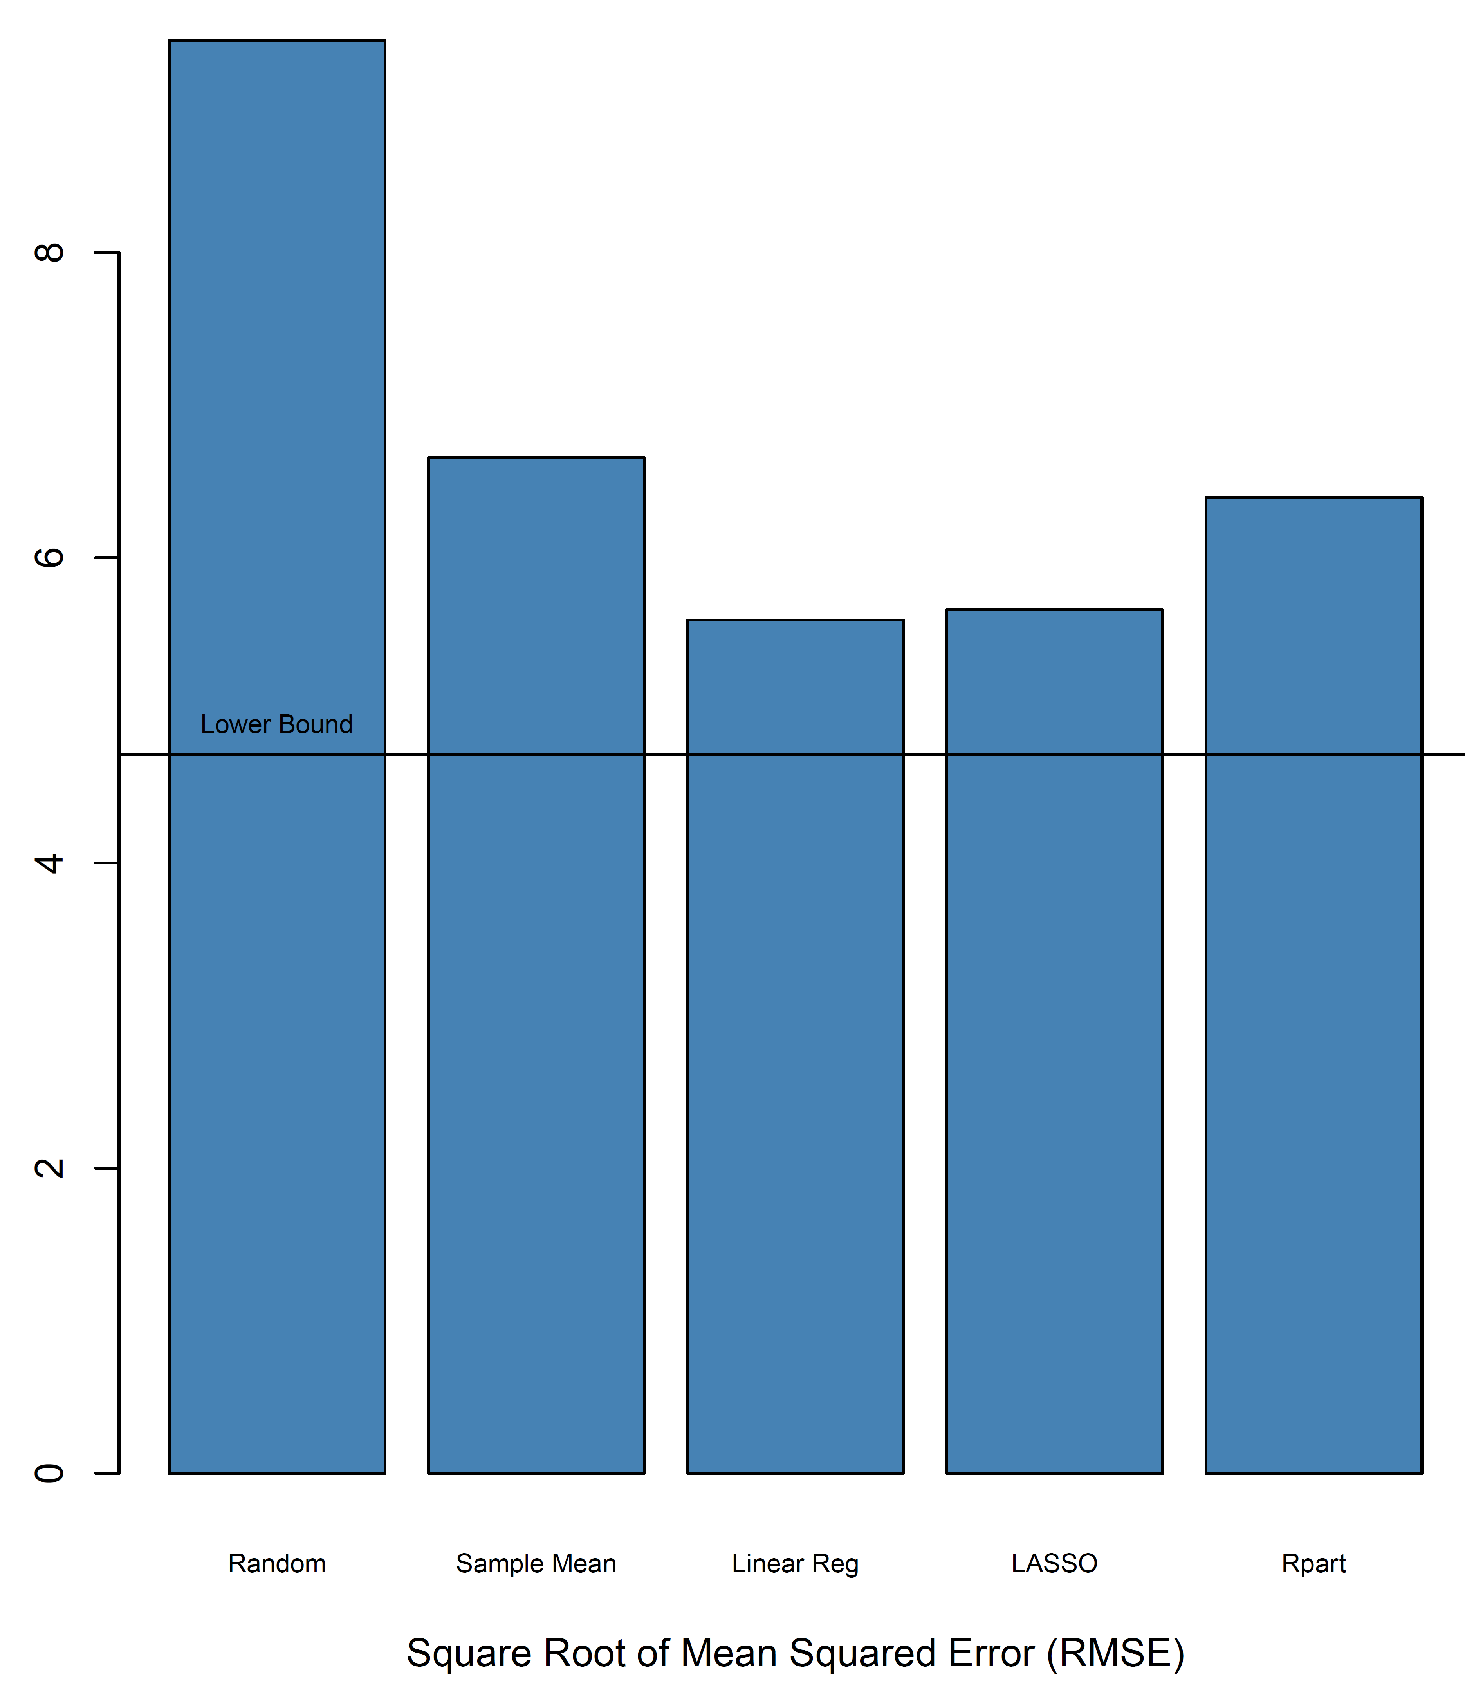
Now, how did we do?
The single “optimal” tree didn’t do any better (in fact significantly worse) than linear regression
What if a small subset of observations overly influenced tree construction?
What if we had chosen a different variable to split the tree differently at the top? We might have gotten a radically different tree…or lots of different trees…

Slide 23
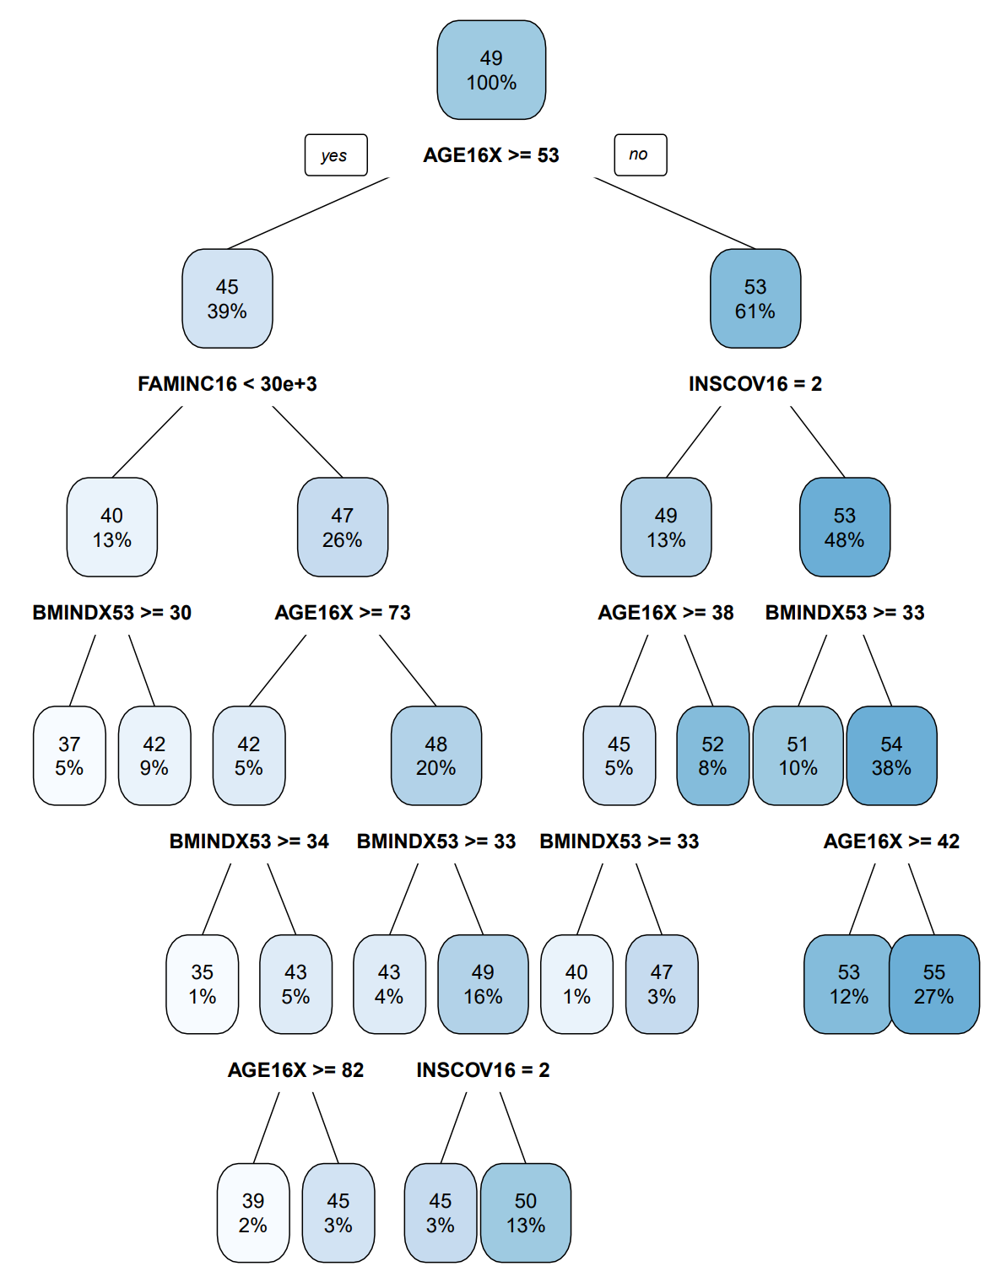
Ensembles of Weak Learners
Sometimes the consensus of a lot of weak models can result in a better prediction than a single strong model.
We can develop an “ensemble” of models, each of which does an OK job of predicting a subset of responses or considering a particular part of the functional relationship.
Consider the tree at right, predicting the SF-12 Physical Component Score as a function of covariates, including:
Age, sex, region, family size, race, ethnicity, marital status, education, BMI, income, poverty status, risk attitude, insurance coverage, usual source of care
What would the tree have looked like if we didn’t split on AGE?
Maybe a subset of observations had really strong relationships with AGE, and a future sample might miss them?
Maybe AGE is so strong that it “masks” other relationships down the tree that may work well for a subset of observations
Ironically, we don’t want strong models because they will be highly correlated.

Slide 24
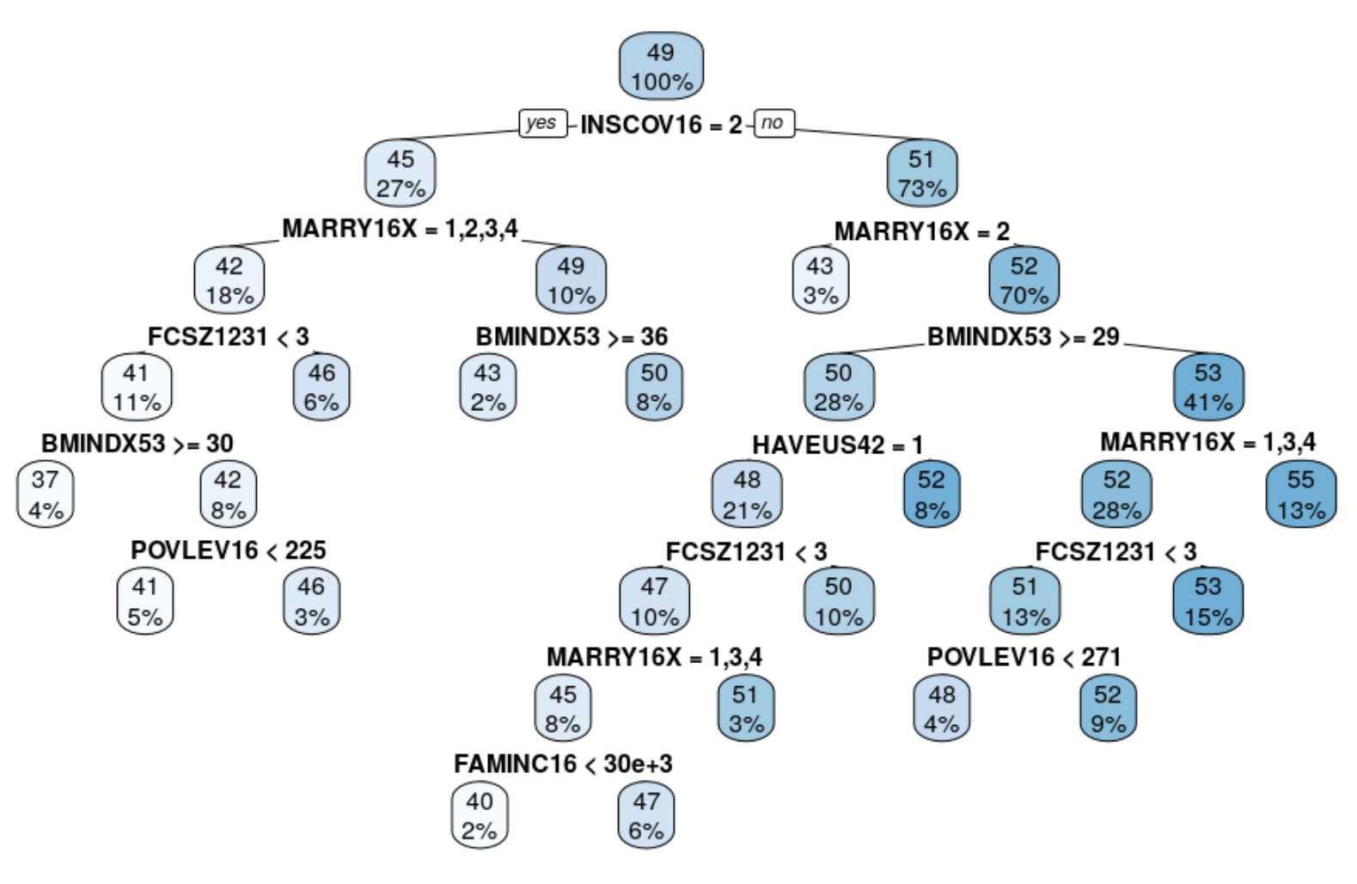

Slide 25






Random Forest
Bagging
Random Feature Selection
Bootstrap the data repeatedly to create an ensemble of trees with varying structure resulting from resampling
At each potential split, the algorithm randomly chooses a subset of all available predictors from which to select the best
Aggregate resulting models (each of which is relatively weak) into a consensus model
Forces the model to be less greedy and uncover potentially deeper interactions masked by strong predictors
Enchanted Forest, Pitlochry, Scotland

Slide 26
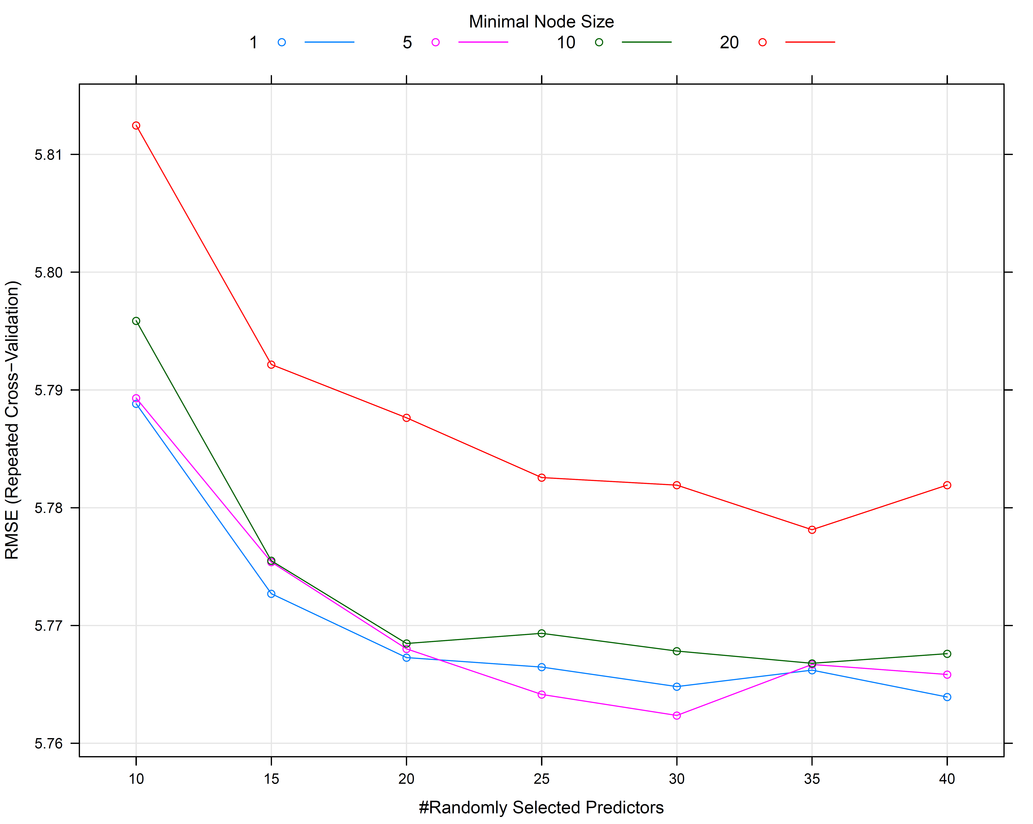
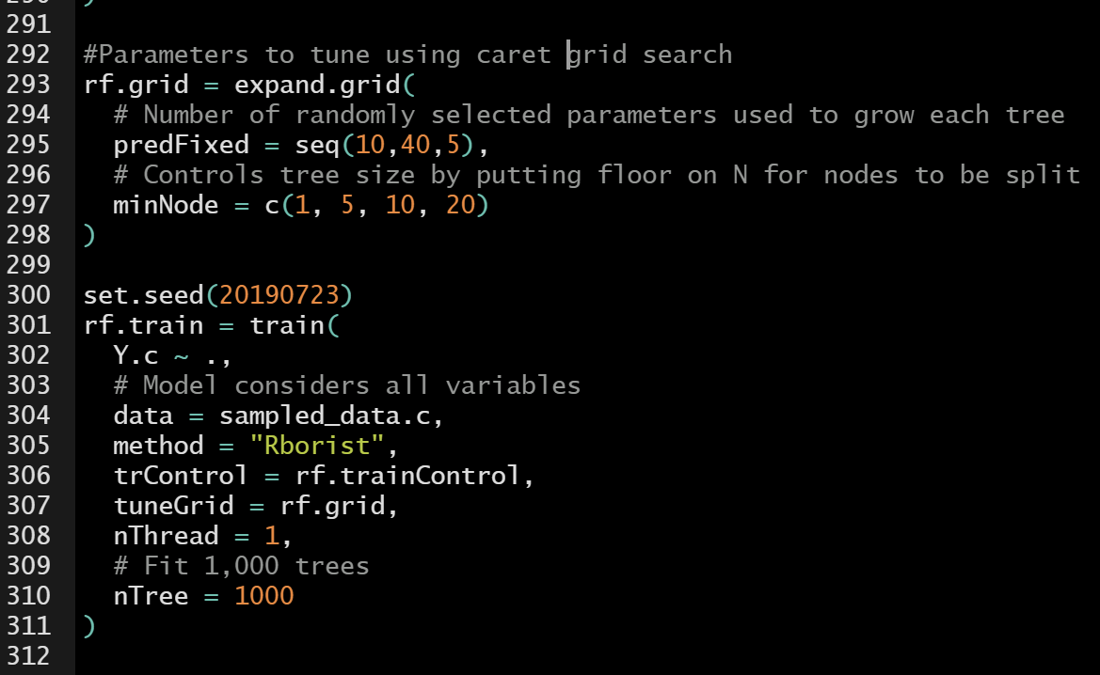
Tuning Ensemble Models
The Random Forest has two key learning parameters to control:
complexity of individual trees
degree of random feature selection
The caret package in R helps “tune” them
R packages:
caret
Rborist

Slide 27

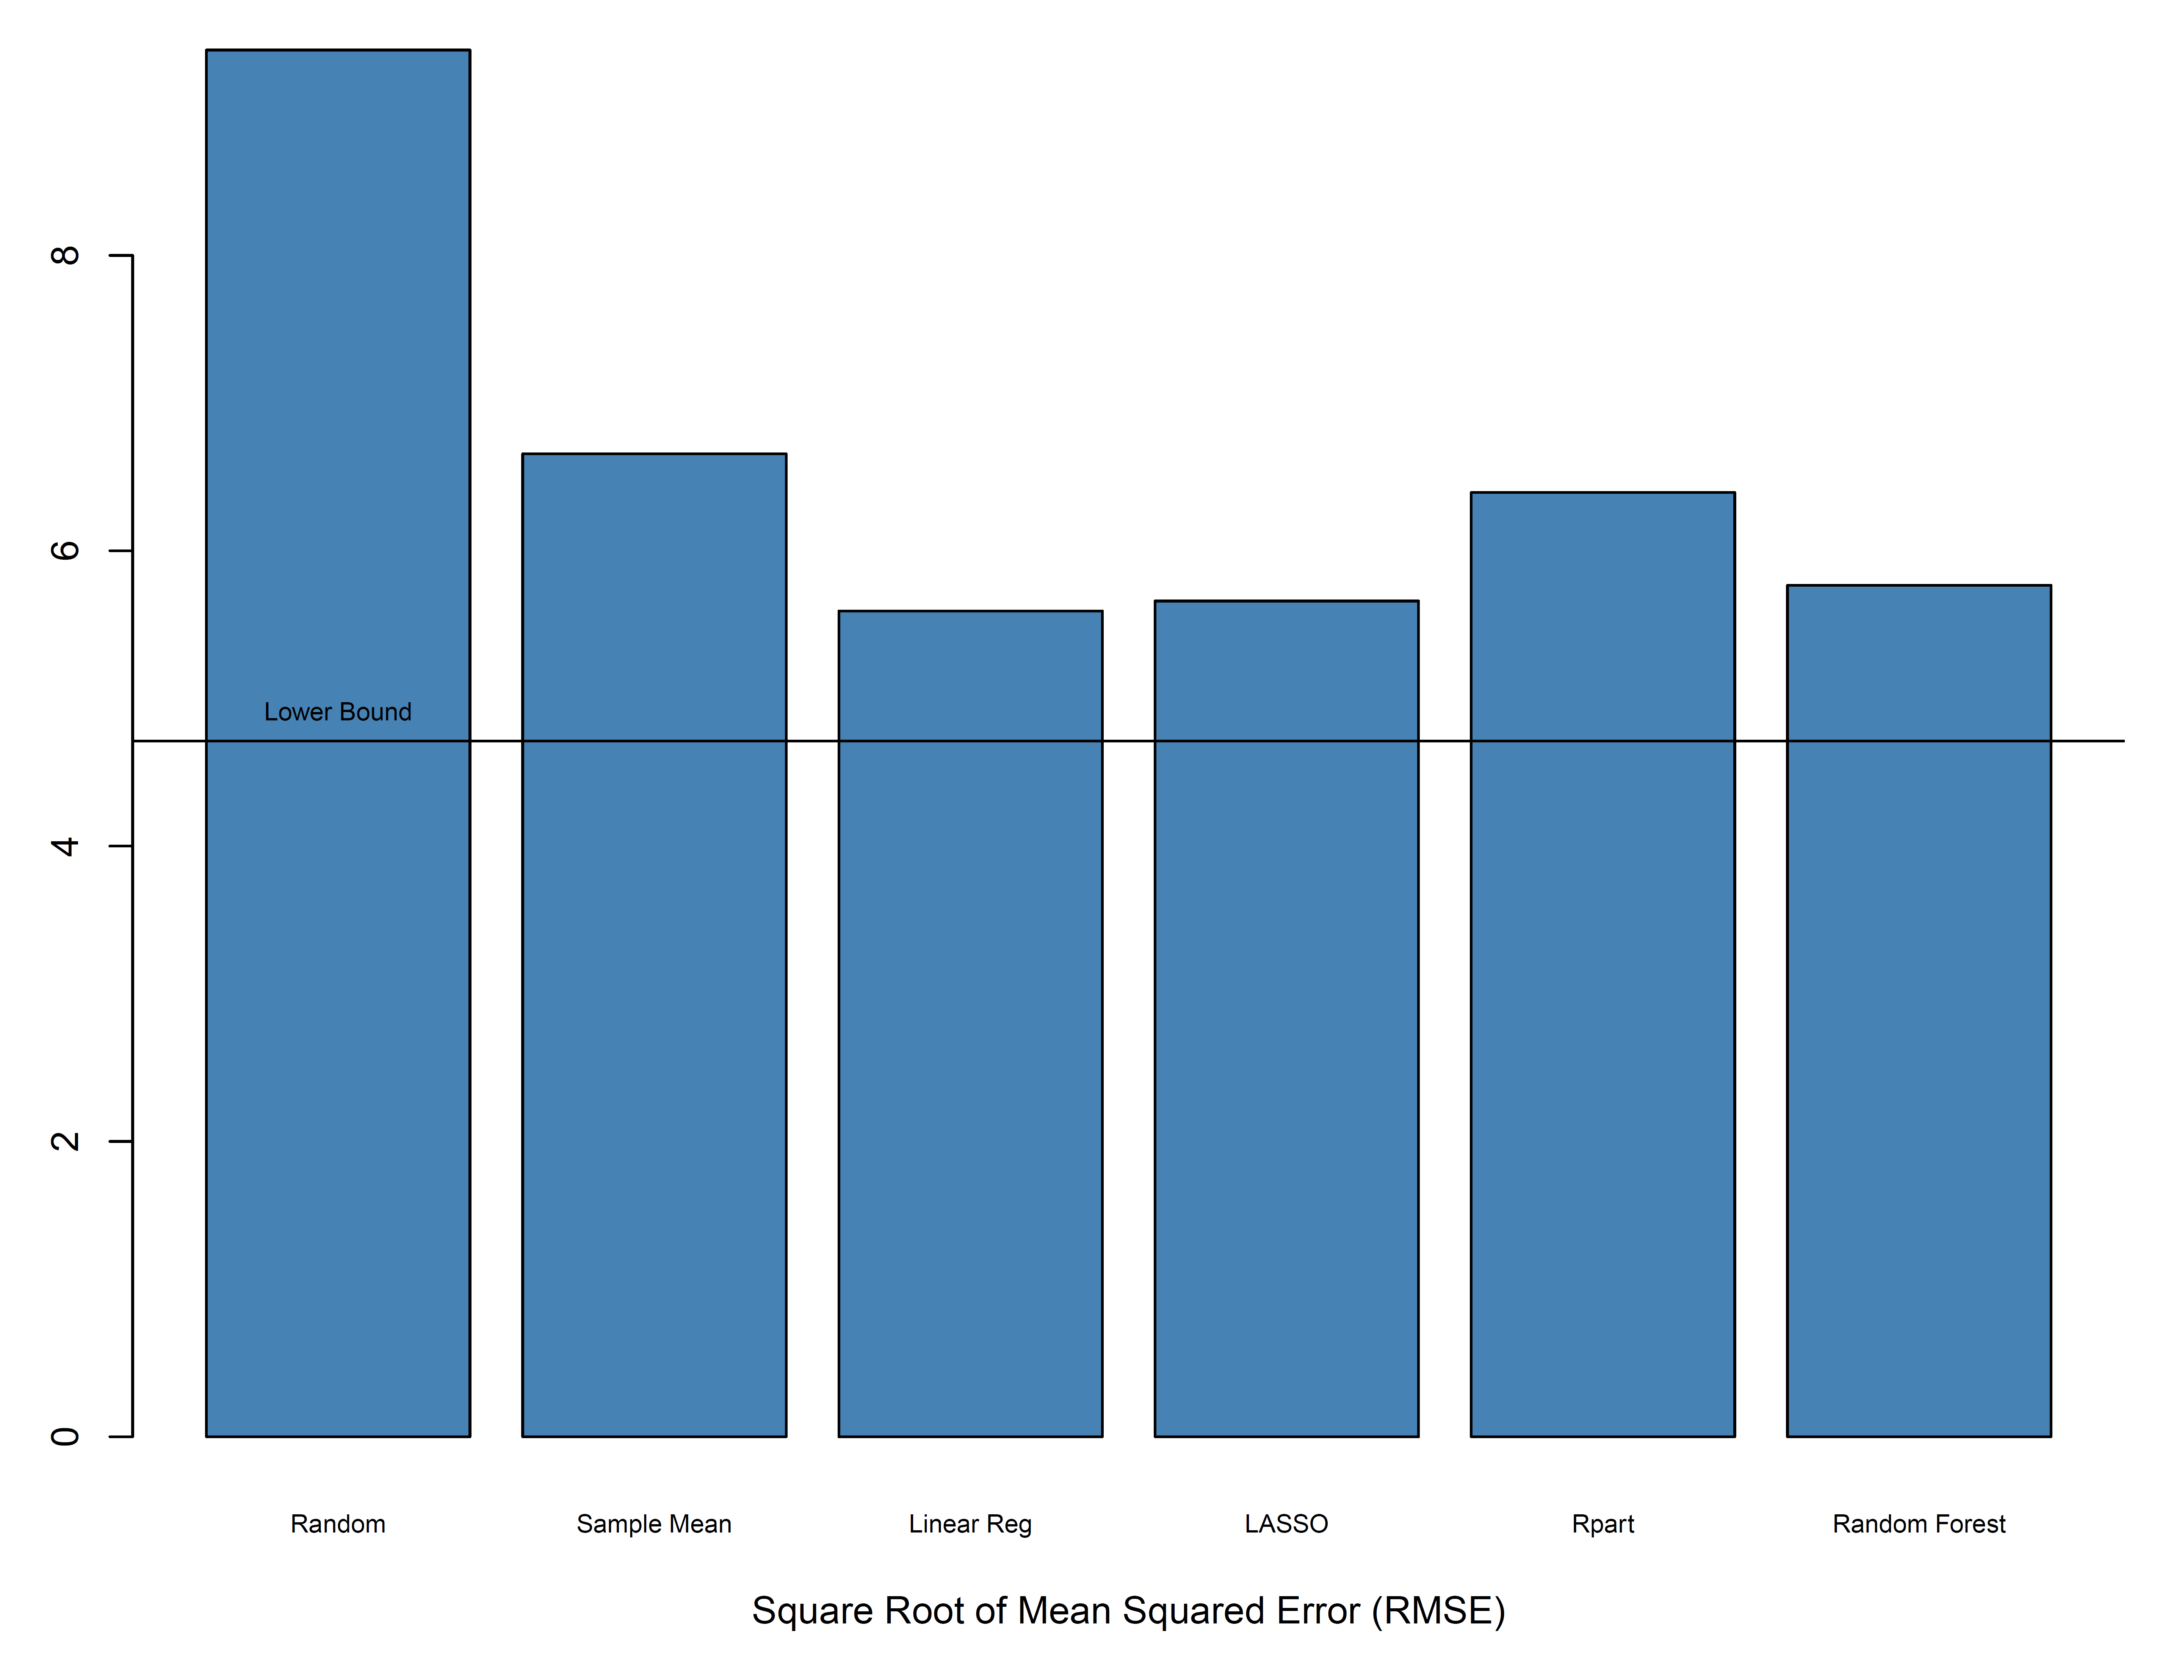

Now, how did we do?

Slide 28
Failures, repeated failures, are finger posts on the road to achievement. One fails forward toward success.
-- C. S. Lewis

Slide 29
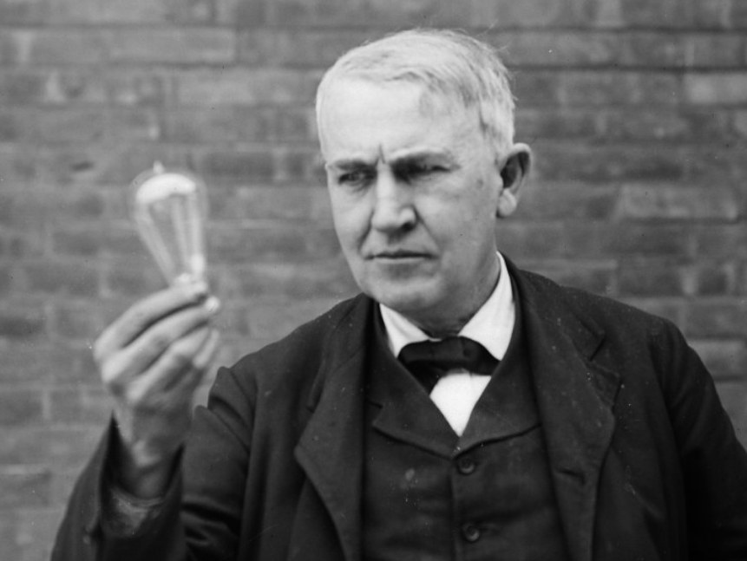
Boosting: Learning from Errors
Boosting algorithms construct a sequence of models, each new model responding to errors generated by previous models up to that point
Upweight observations with poor predictions: adaboost
Fit new model on the residuals of the previous model: gradient boosting
Thomas Edison, 1911

Slide 30

Gradient Boosting
Consider a first approximation model: ${\hat{Y}}_{1}={\hat{f}}_{1}(X)$ chosen to minimize squared loss:
$${\left(Y−{\hat{f}}_{1}\left(X\right)\right)}^{2}$$
Where $Y−{\hat{f}}_{1}\left(X\right)=ε_{1}$
Imagine a perfect model $f_{∗}\left(X\right)$that you could add to ${\hat{f}}_{1}\left(X\right)$ to yield perfect predictions. Using calculus of optimization:
$$\min{{\left(Y −\left({\hat{f}}_{1}\left(X\right)+f_{∗}\left(X\right)\right)\right)}^{2}}$$
$\frac{∂{\left(Y −\left({\hat{f}}_{1}\left(X\right)+f_{∗}\left(X\right)\right)\right)}^{2}}{∂f_{∗}(X)}=0$
Applying the chain rule:
$$−2\left(Y −\left({\hat{f}}_{1}\left(X\right)+f_{∗}\left(X\right)\right)\right)=0$$
$$f_{∗}\left(X\right)=Y −{\hat{f}}_{1}\left(X\right)=ε_{1}$$
So our goal for the second stage model ${\hat{f}}_{2}$is to try to approximate $f_{∗}\left(X\right)=ε_{1}$ , the residuals from the first stage…
After the second stage, repeat the process replacing ${\hat{f}}_{1}$with ${\hat{f}}_{1}+η{\hat{f}}_{2}$ , calculating residuals from the updated model, and repeat…
An initial model is used to generate a prediction and calculate residuals
A subsequent model is then fit on residuals of the previous model. Bootstrapped resamples may be used (stochastic gradient boosting)
Repeat steps 2 and 3 until a sufficiency threshold is met
An updated prediction is generated from the weighted sum of the initial and subsequent model
Develop consensus estimate as weighted sum of models. Sequence of weights is called the “learning rate” or the “shrinkage” rate of the algorithm.

Slide 31
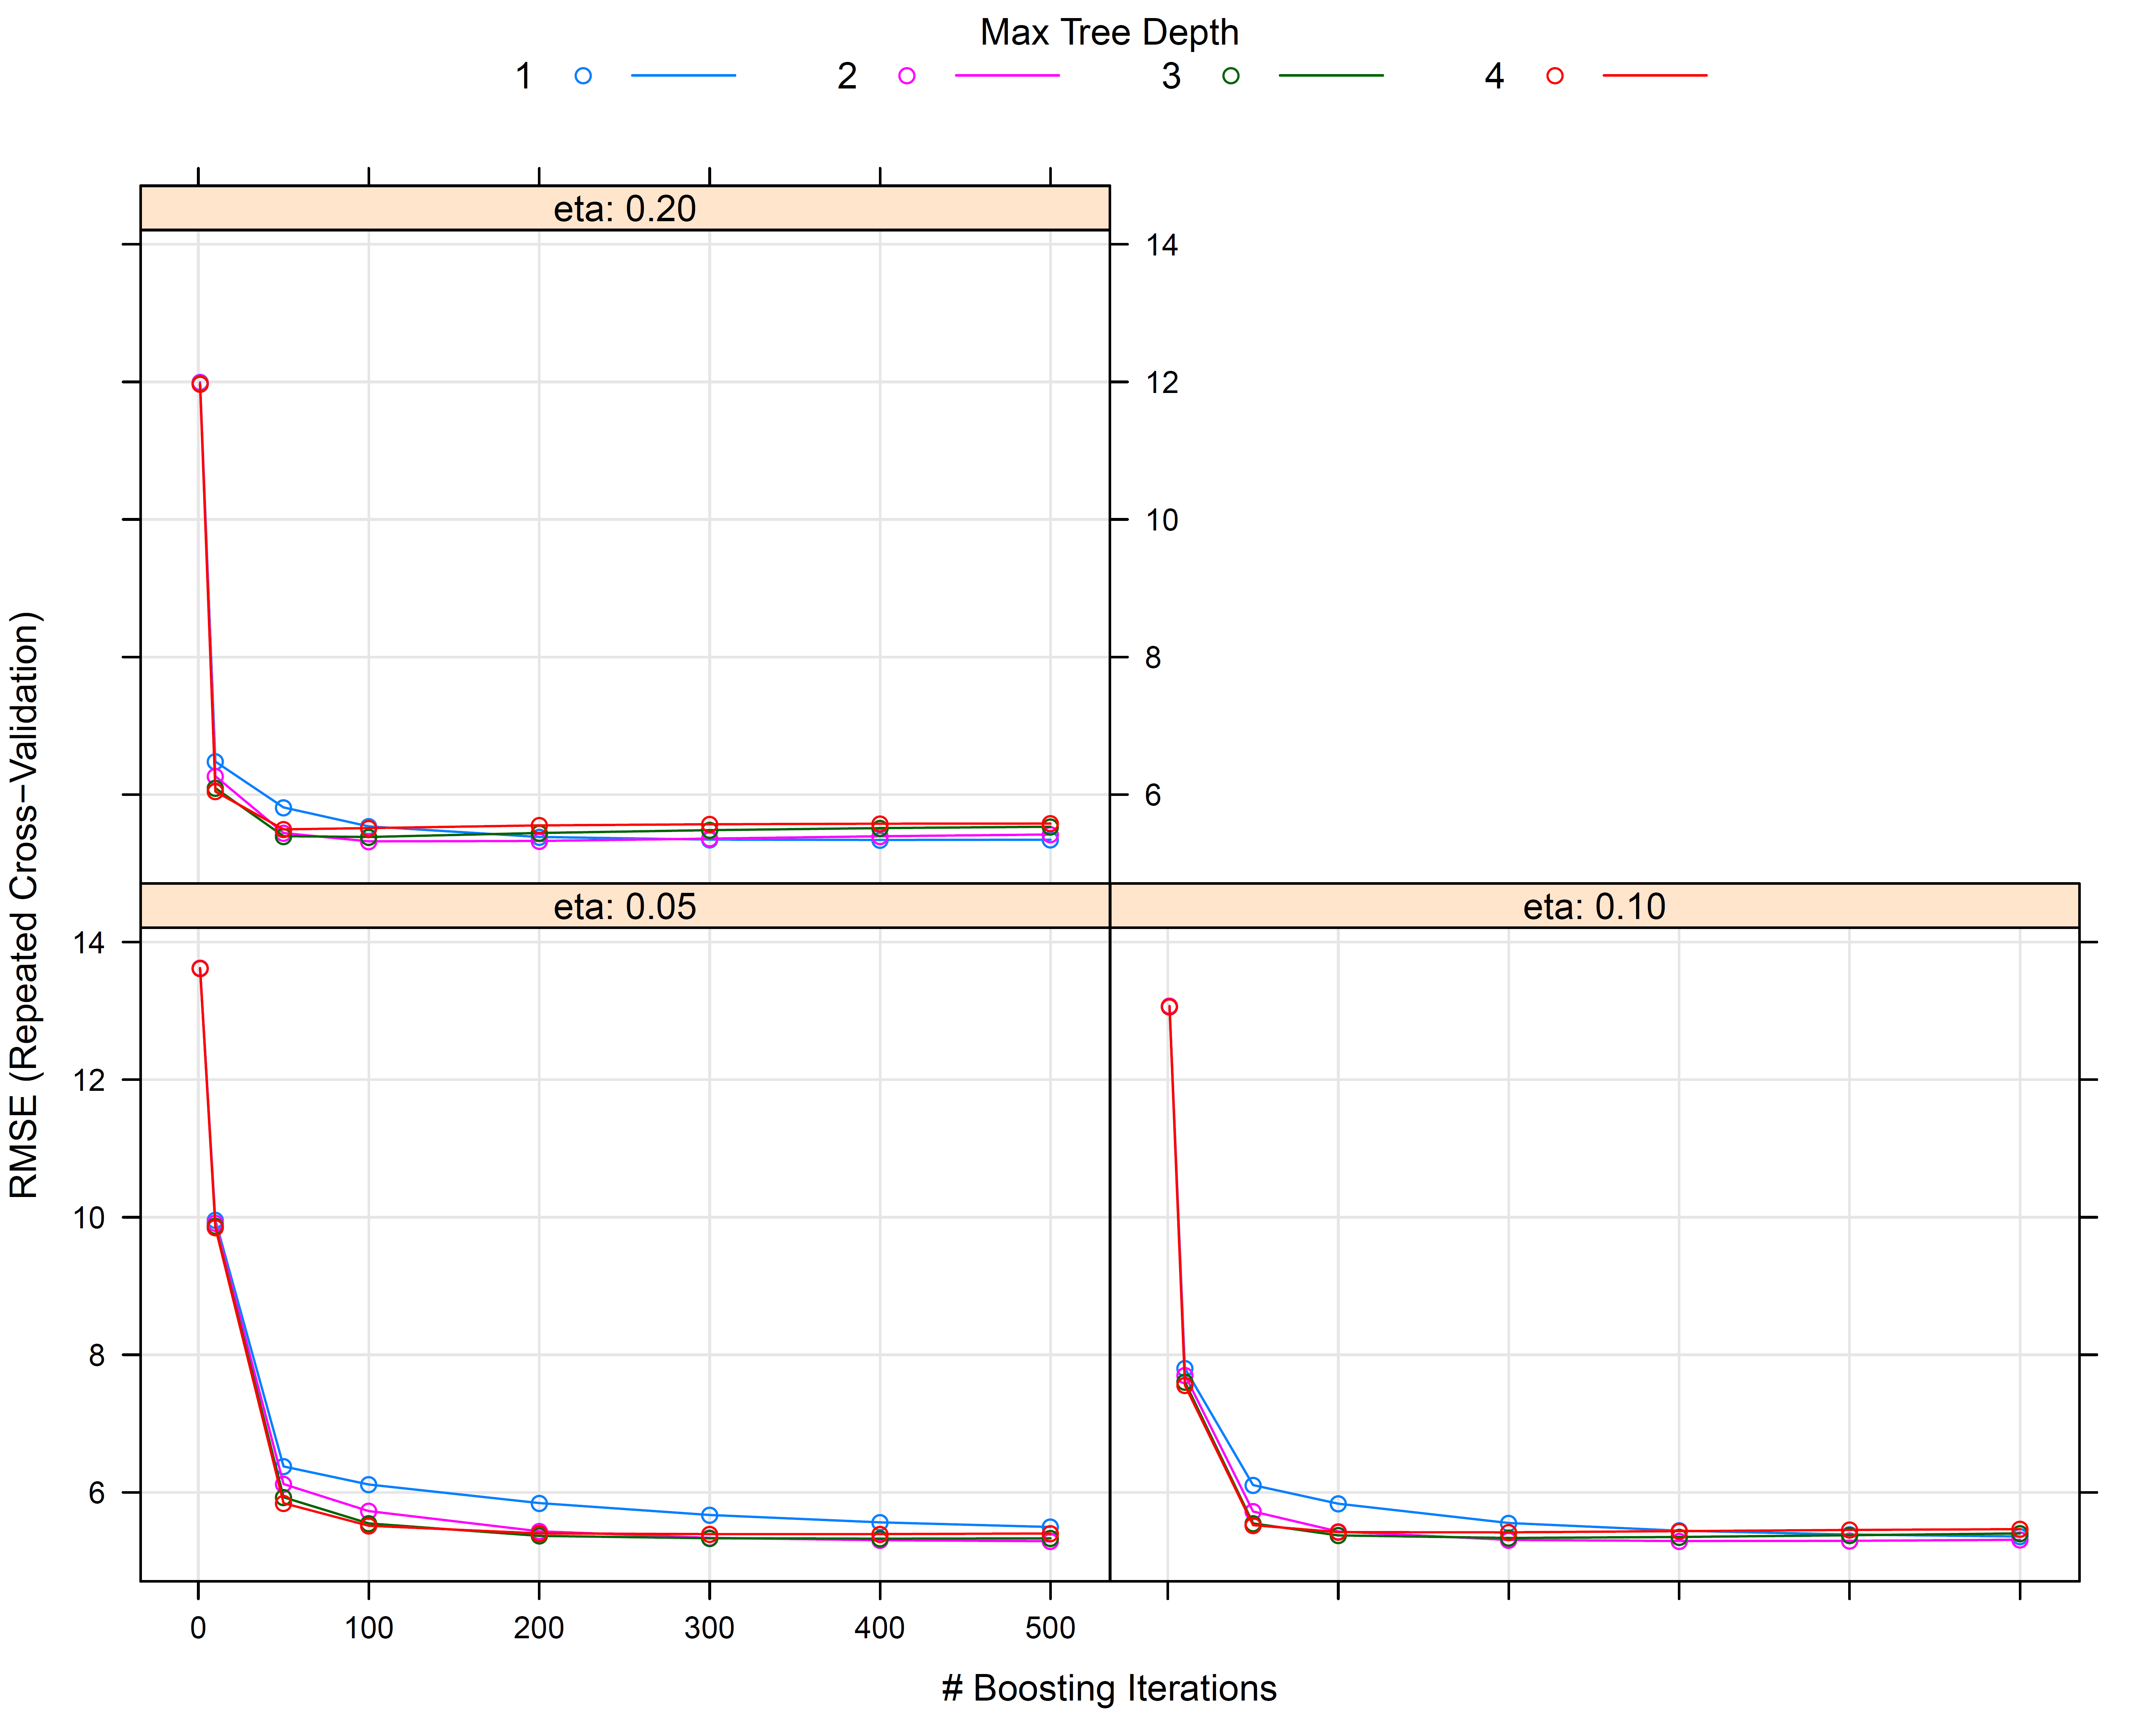
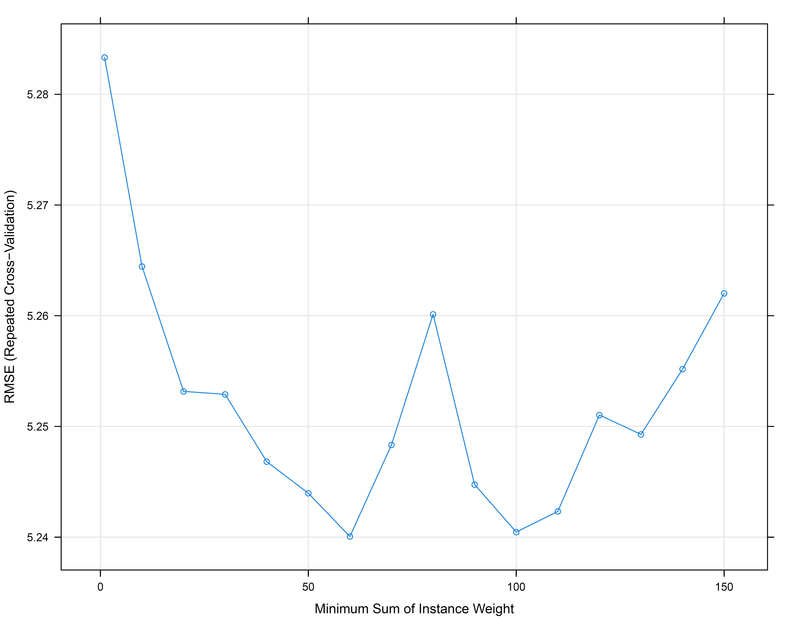
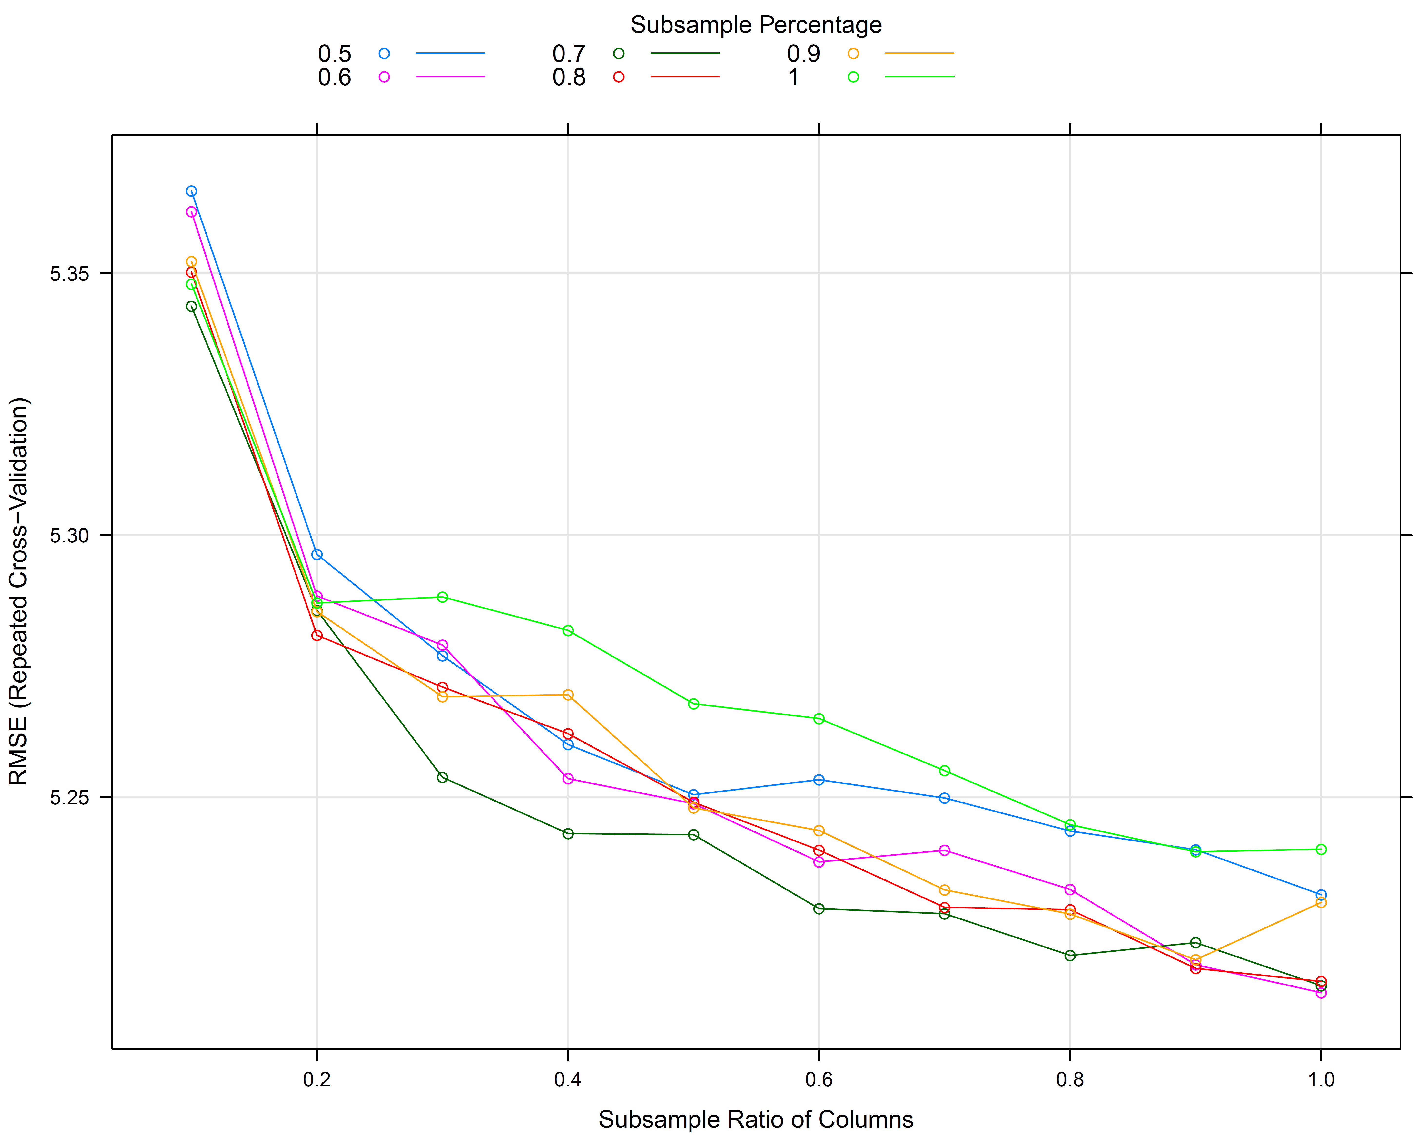
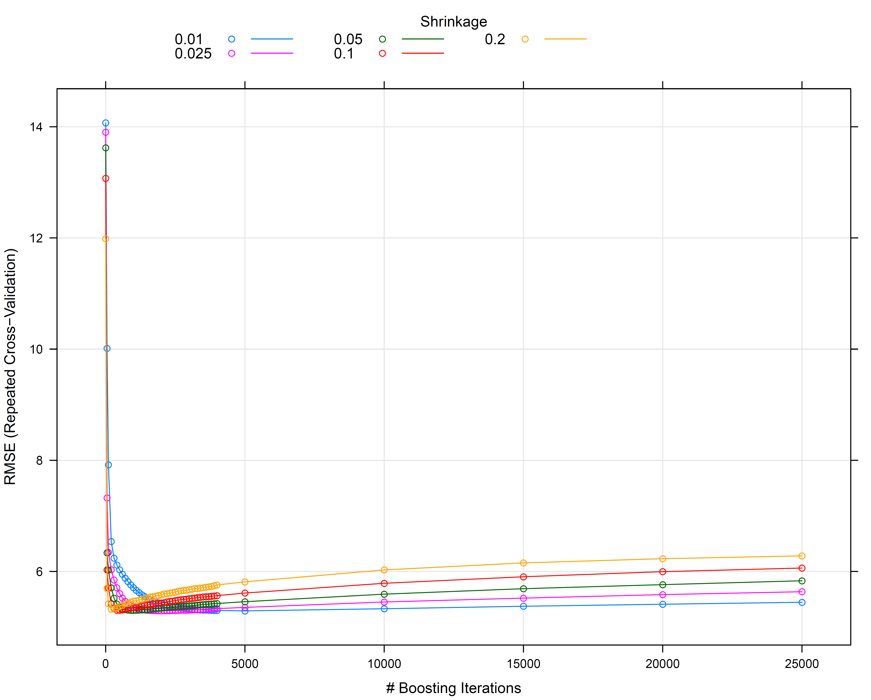
Extreme Gradient Boosting (Xgboost)
Several tunable parameters, including:
Maximum tree depth
Minimum size needed to split
Degree of random feature selection
Degree of random case selection
Number of trees constructed
eta: learning rate (shrinkage)
R packages:
caret
xgboost

Slide 32
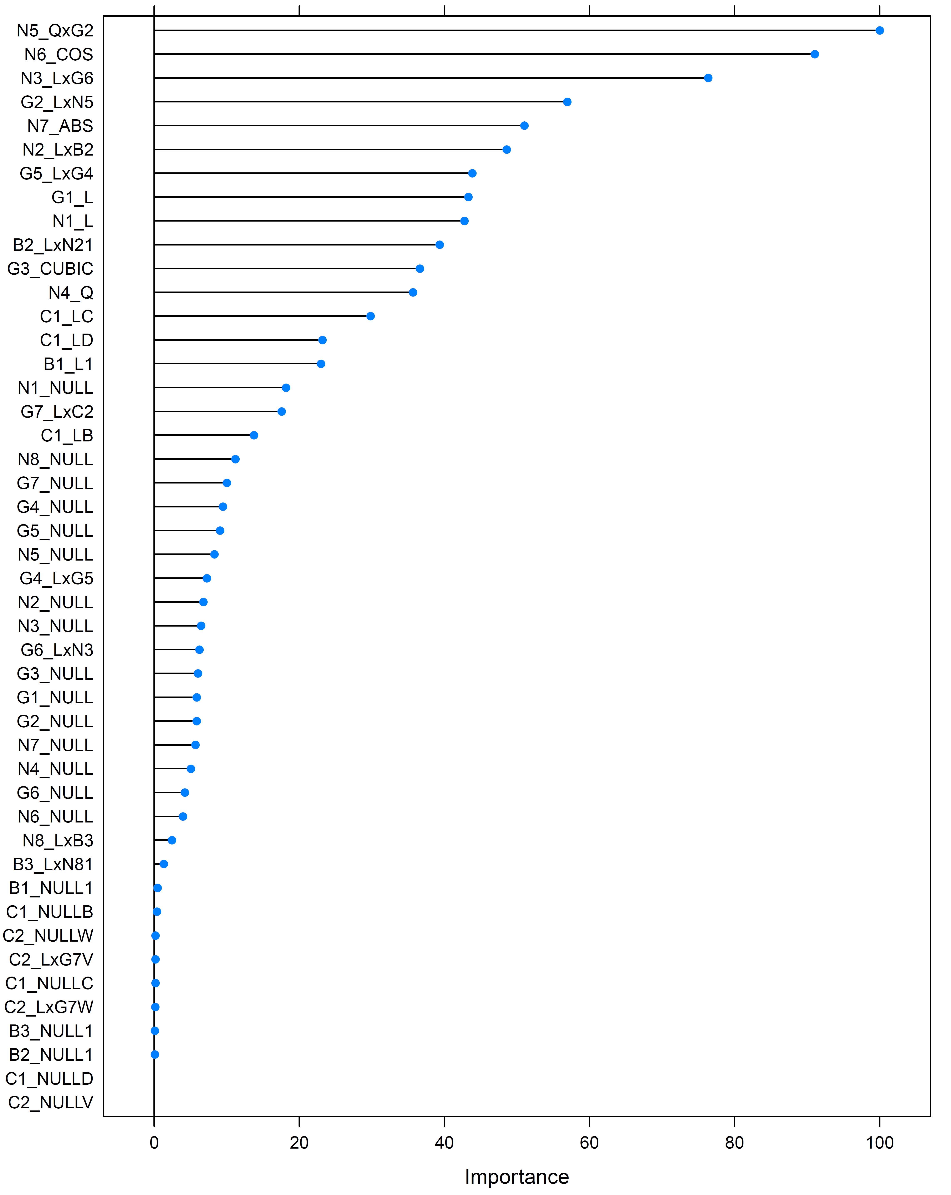
Feature Importance
Cross-validation and ensemble construction helps explore predictor importance:
Which features show up most often in the trees (and higher up in them)?
Which features, if removed from consideration, result in substantially worse prediction?
Most of these variables are false targets

Slide 33
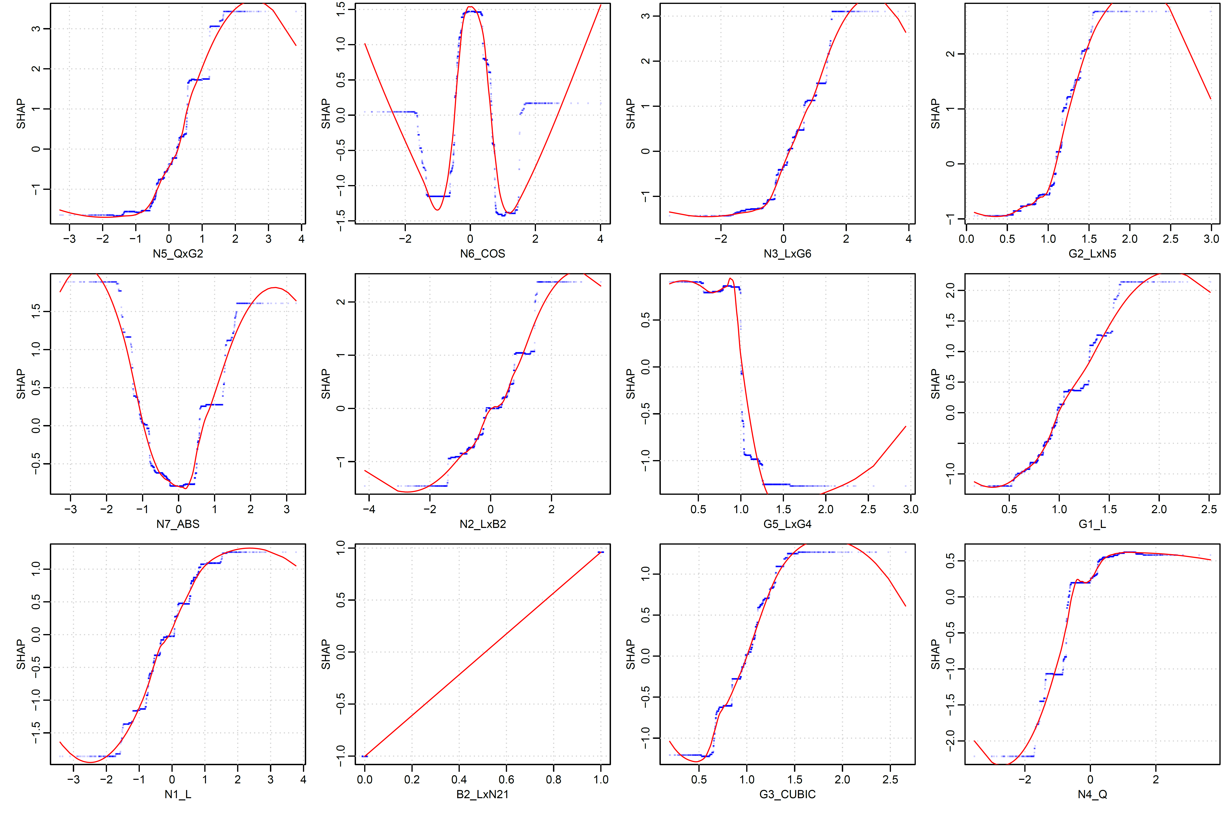
Partial Dependence
Hard to interpret ensemble models (“black box” problem).
Can we relate back to the original functional approximation problem?
SHAP (Shapley) values look at the contribution of each predictor to the overall prediction at different values, conditional on other predictors.

Slide 34
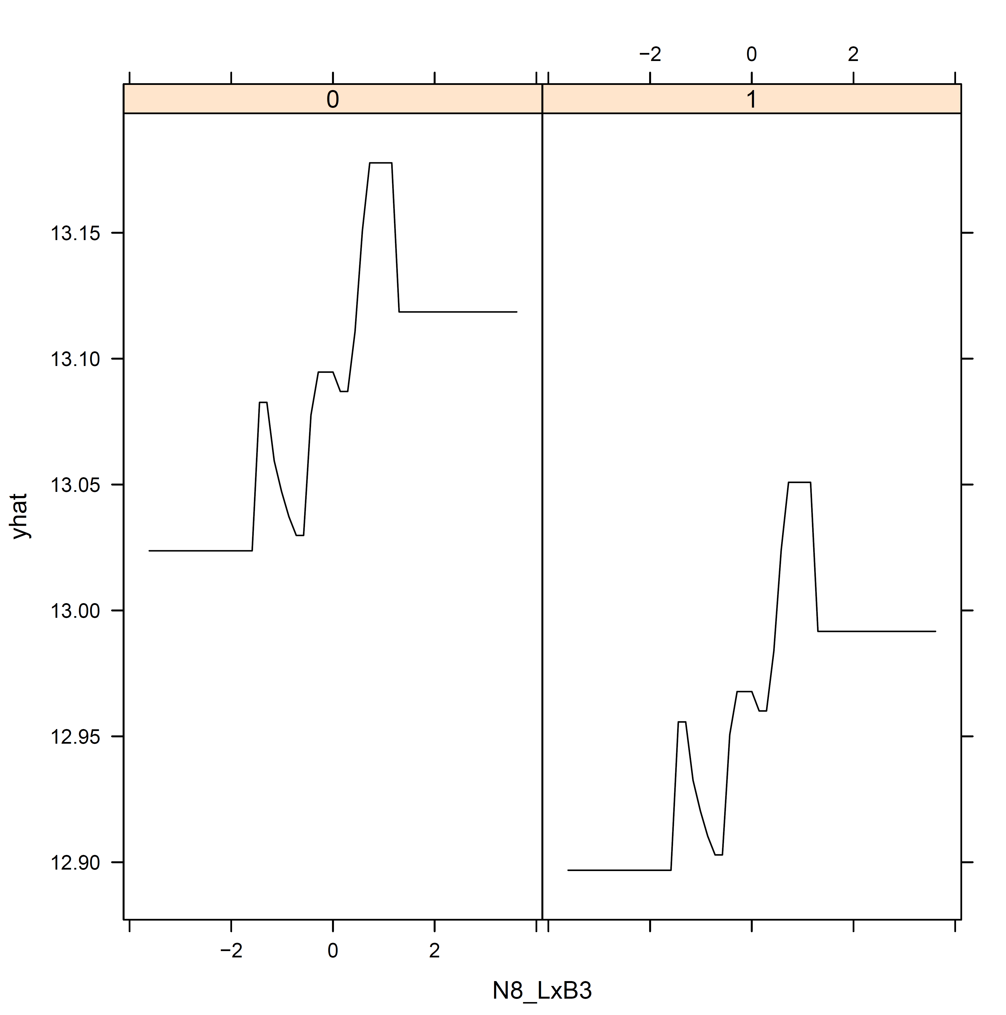
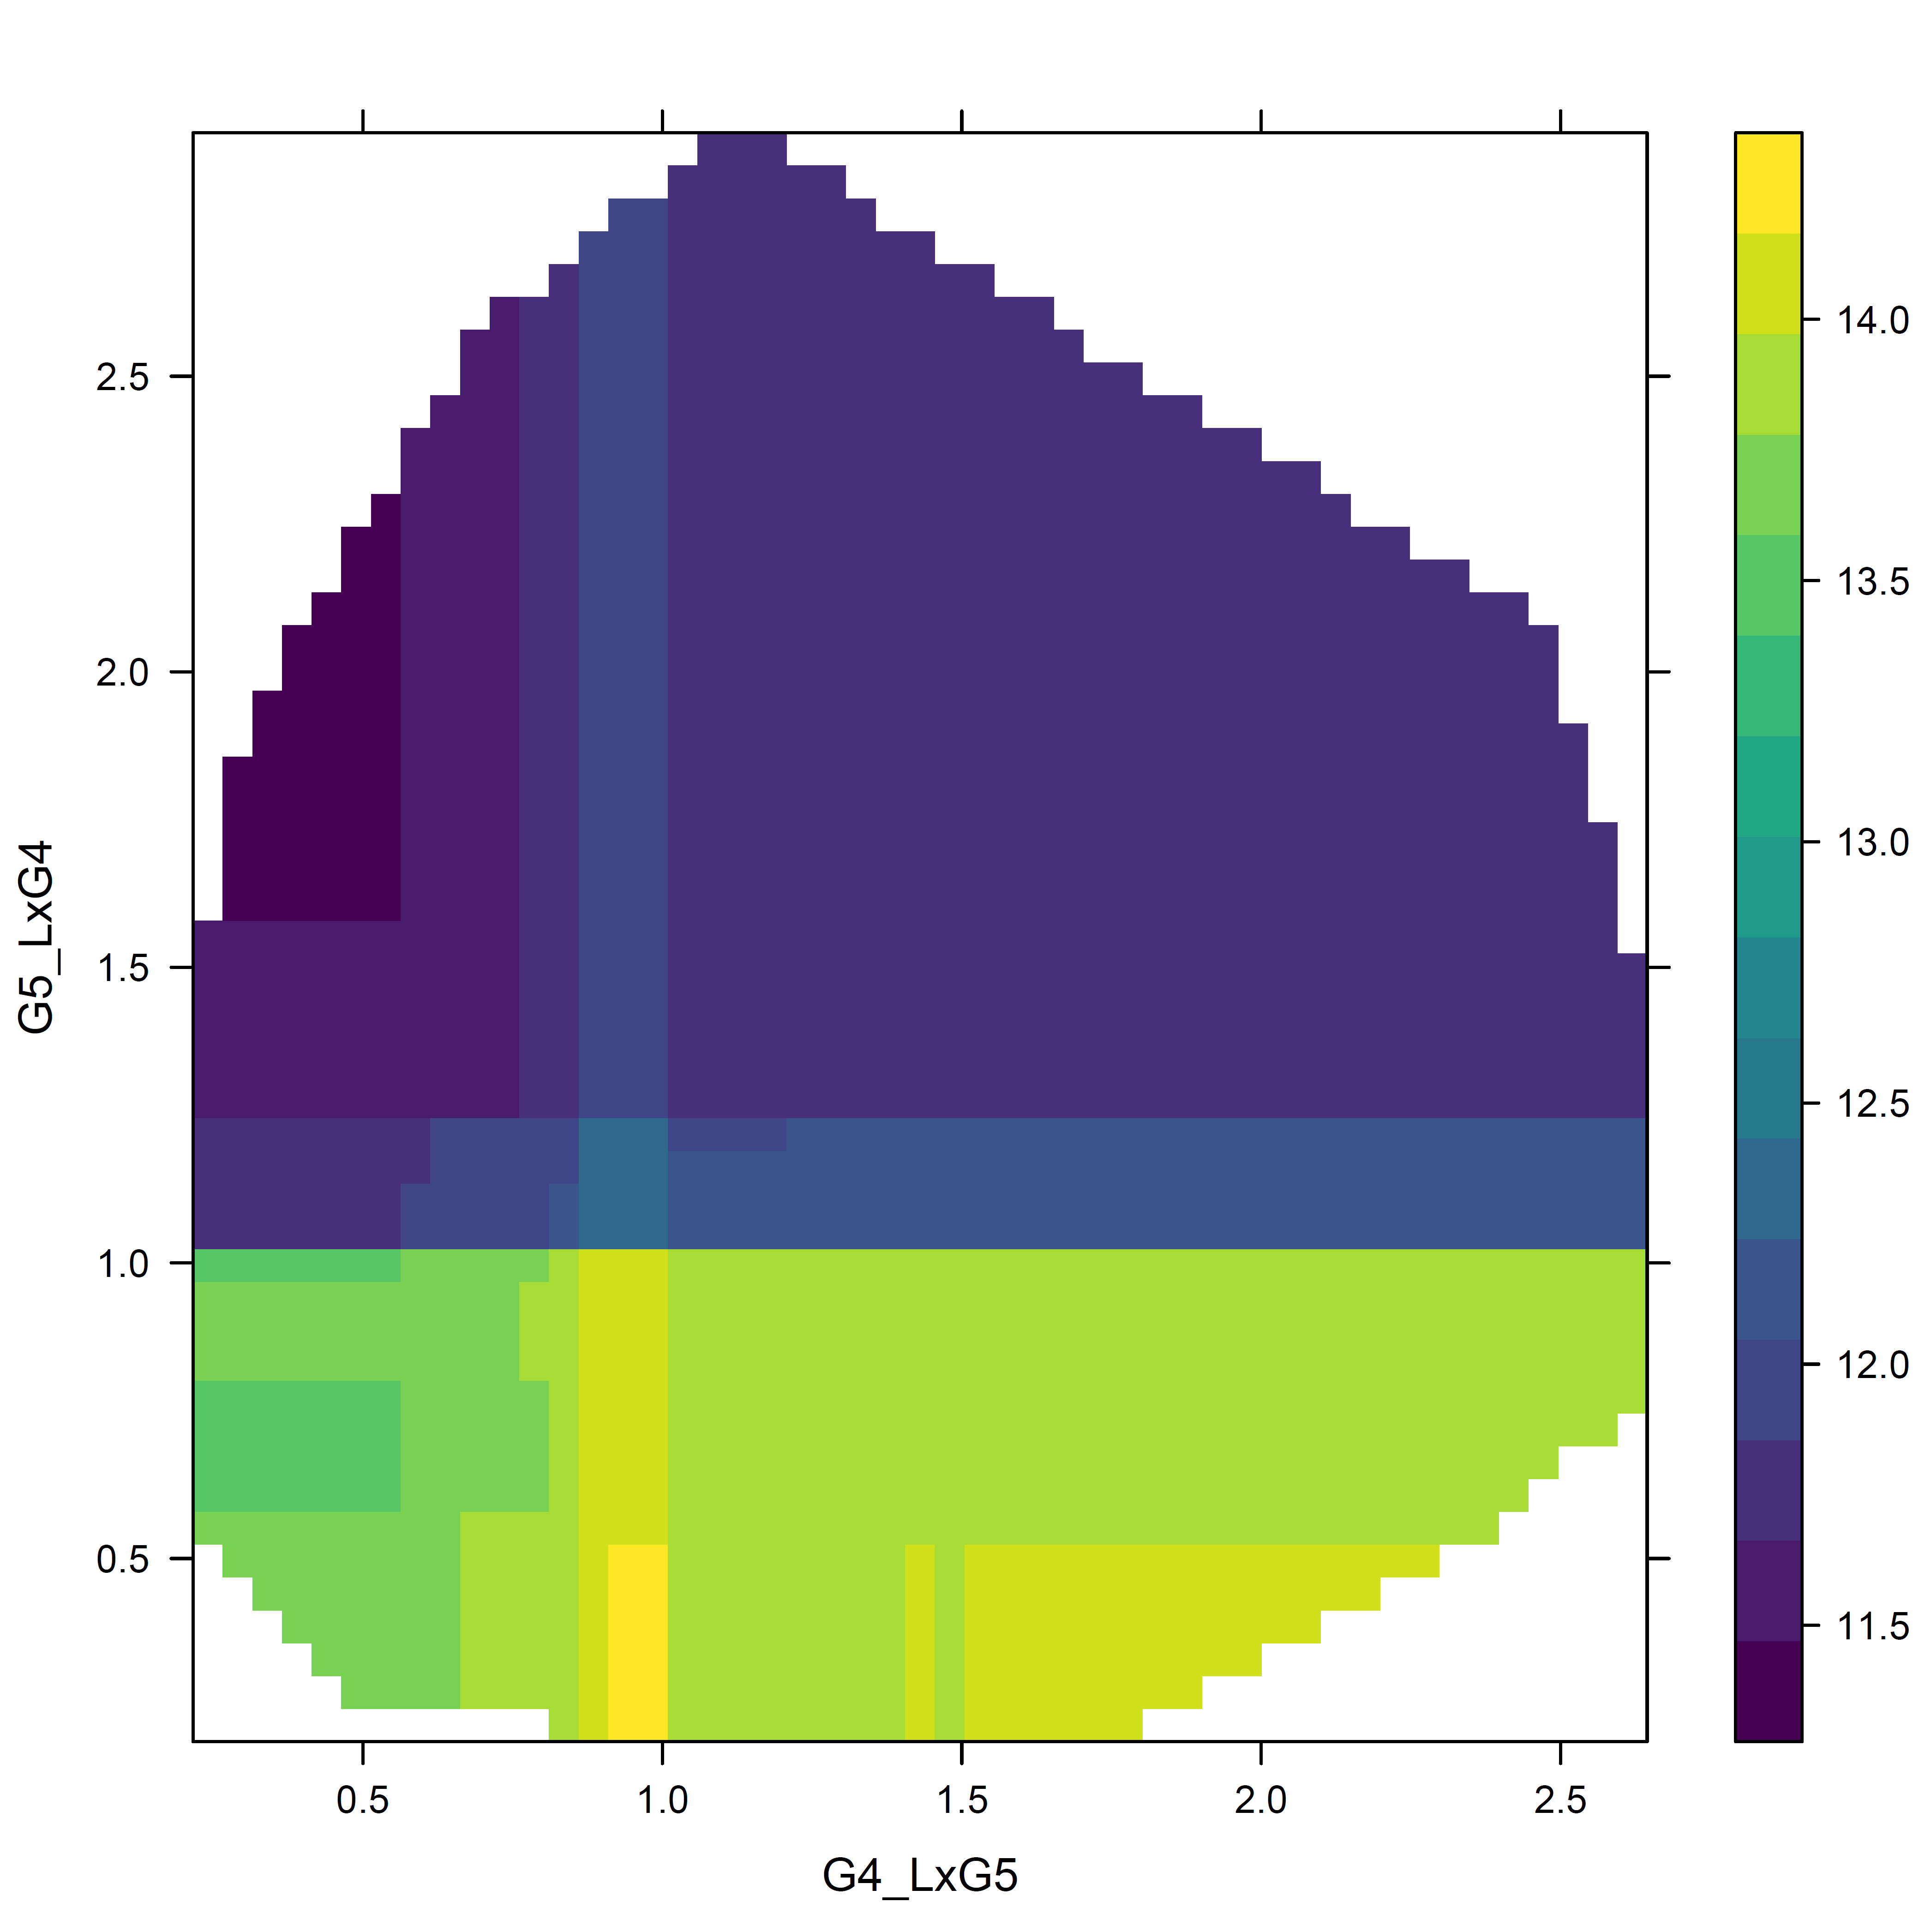
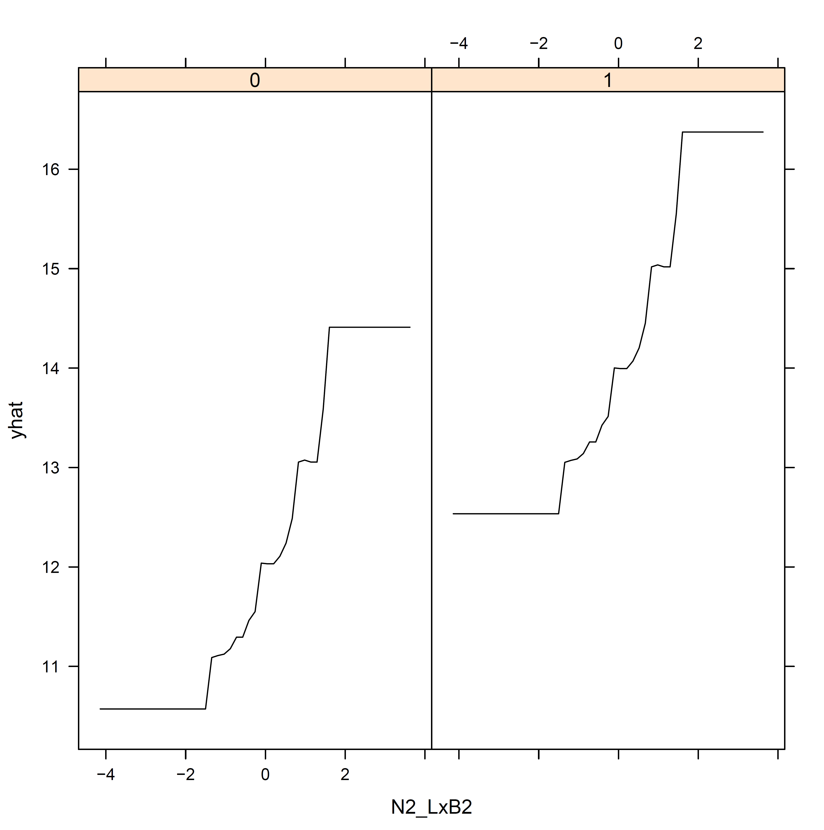
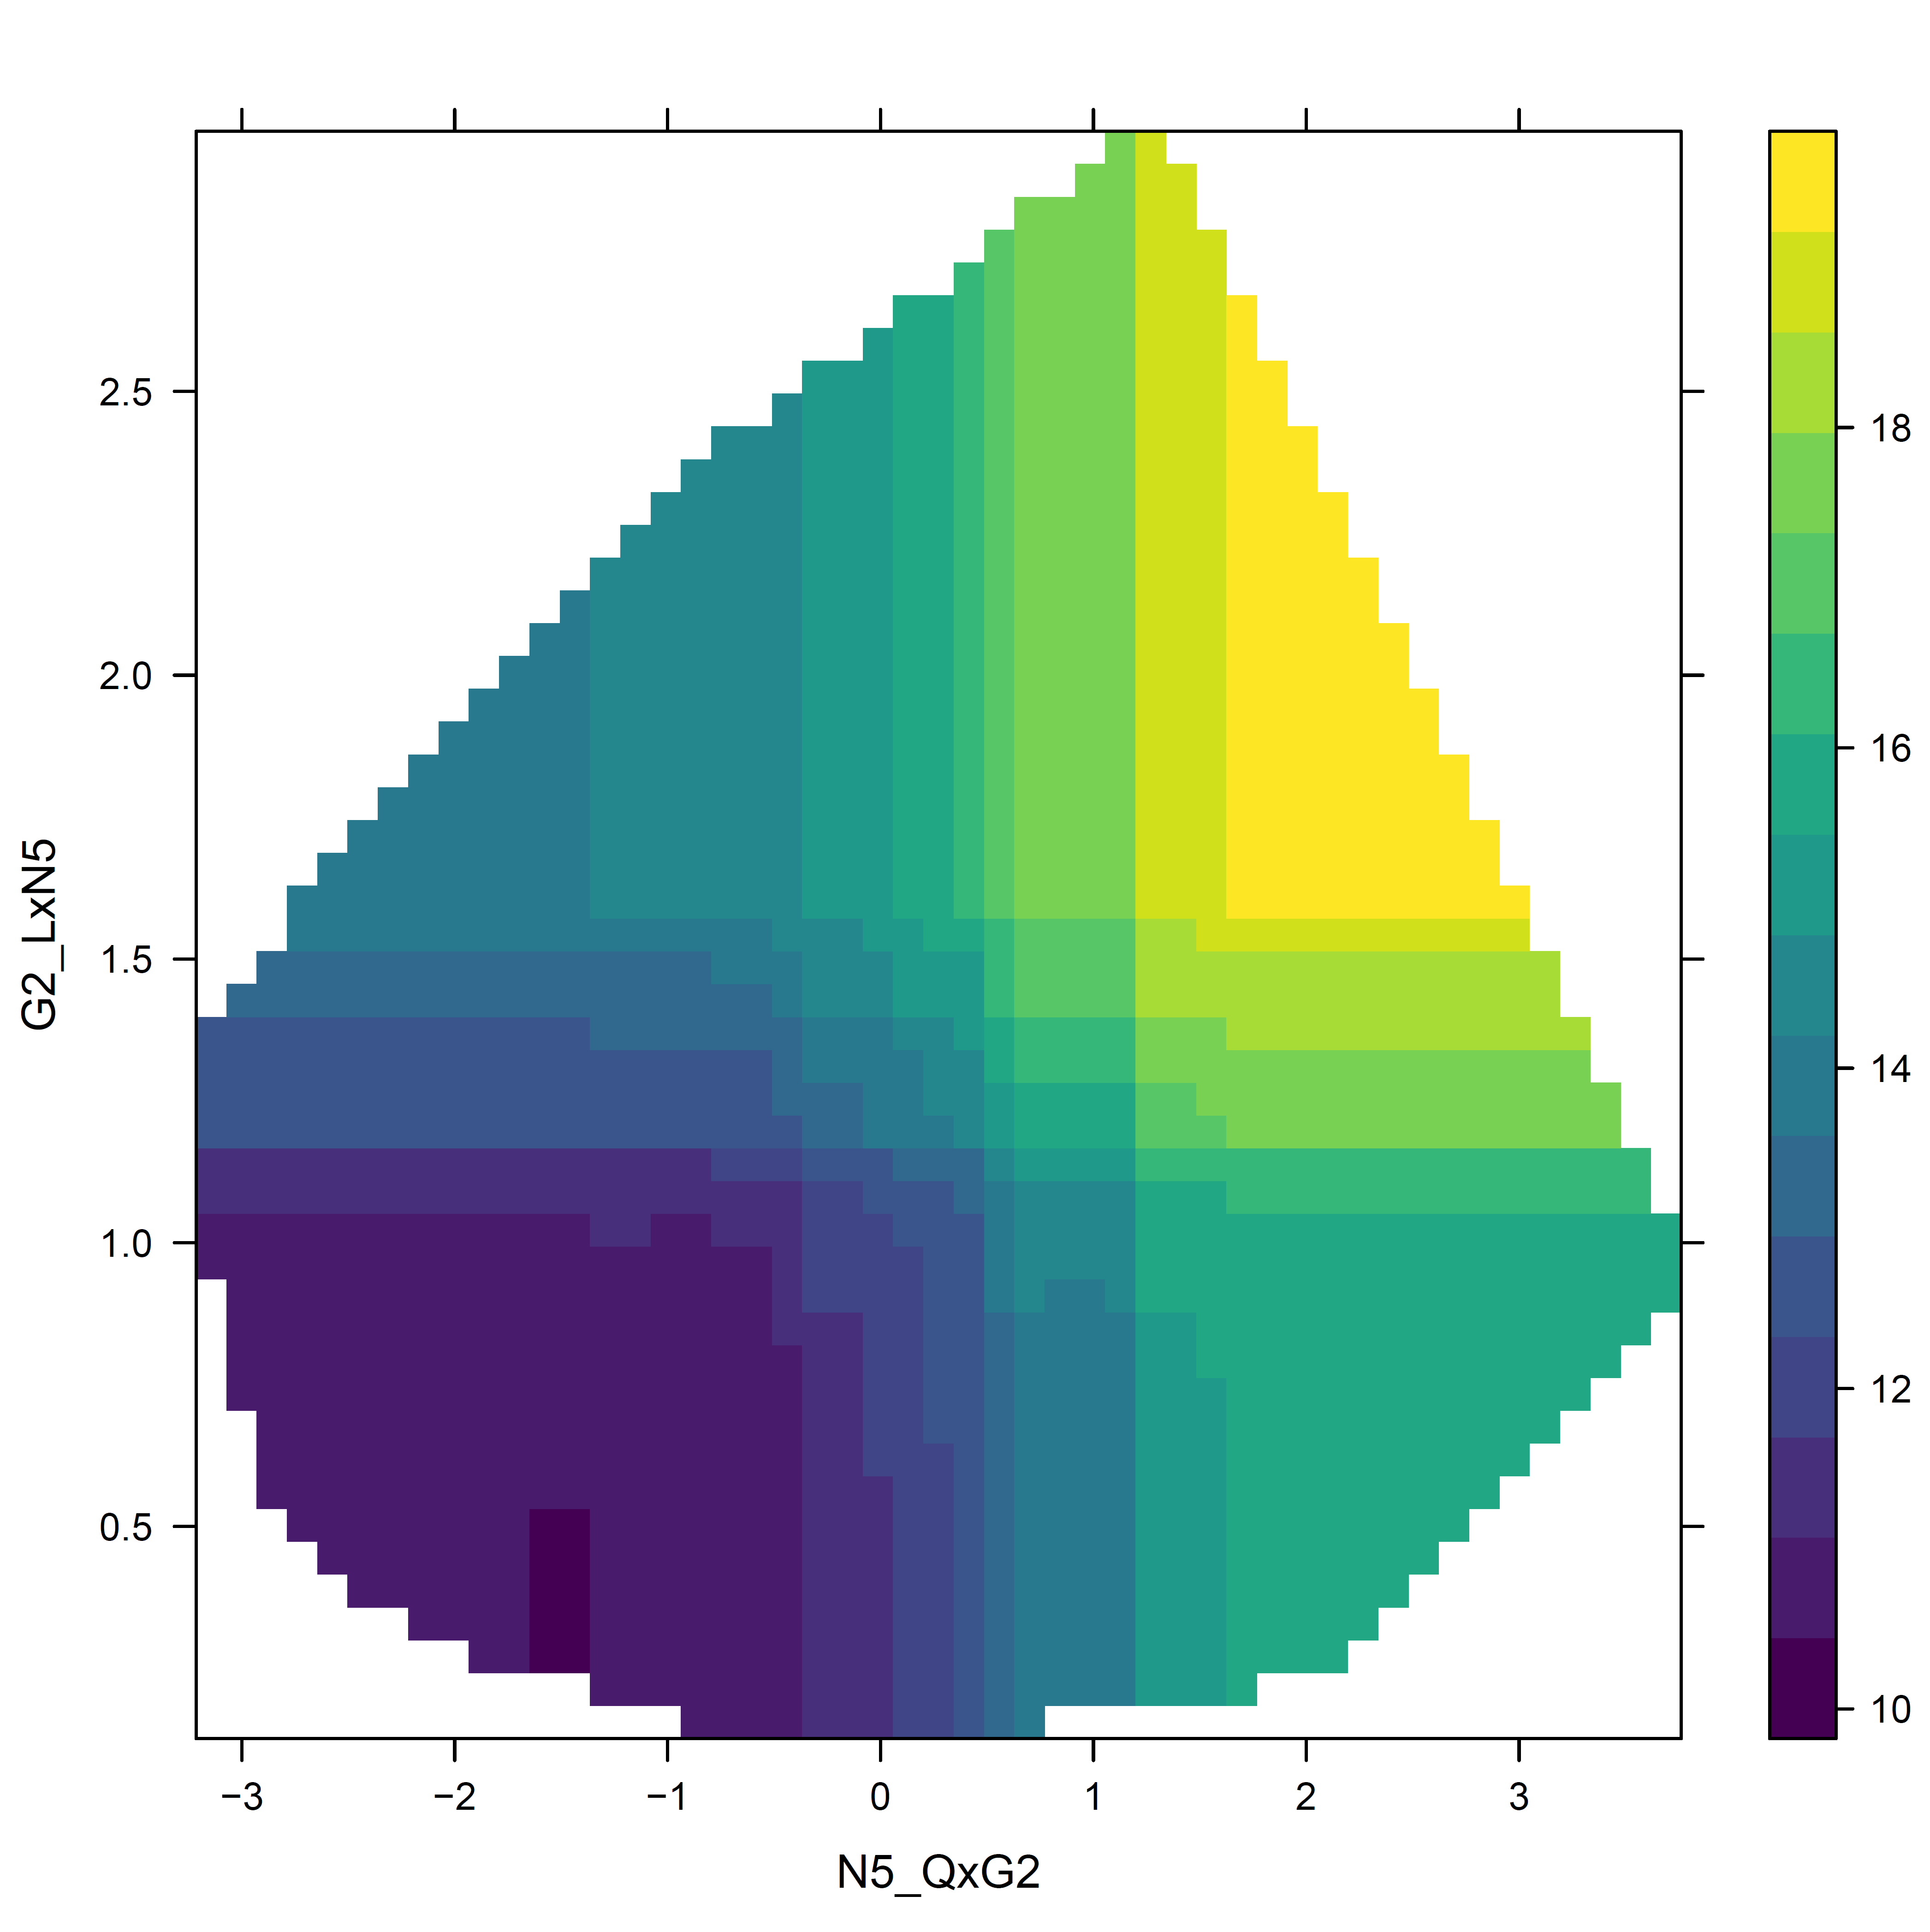
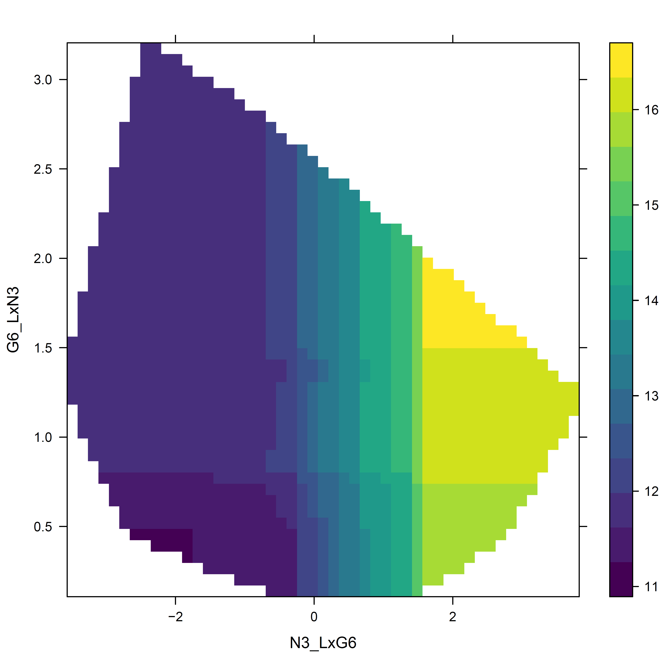
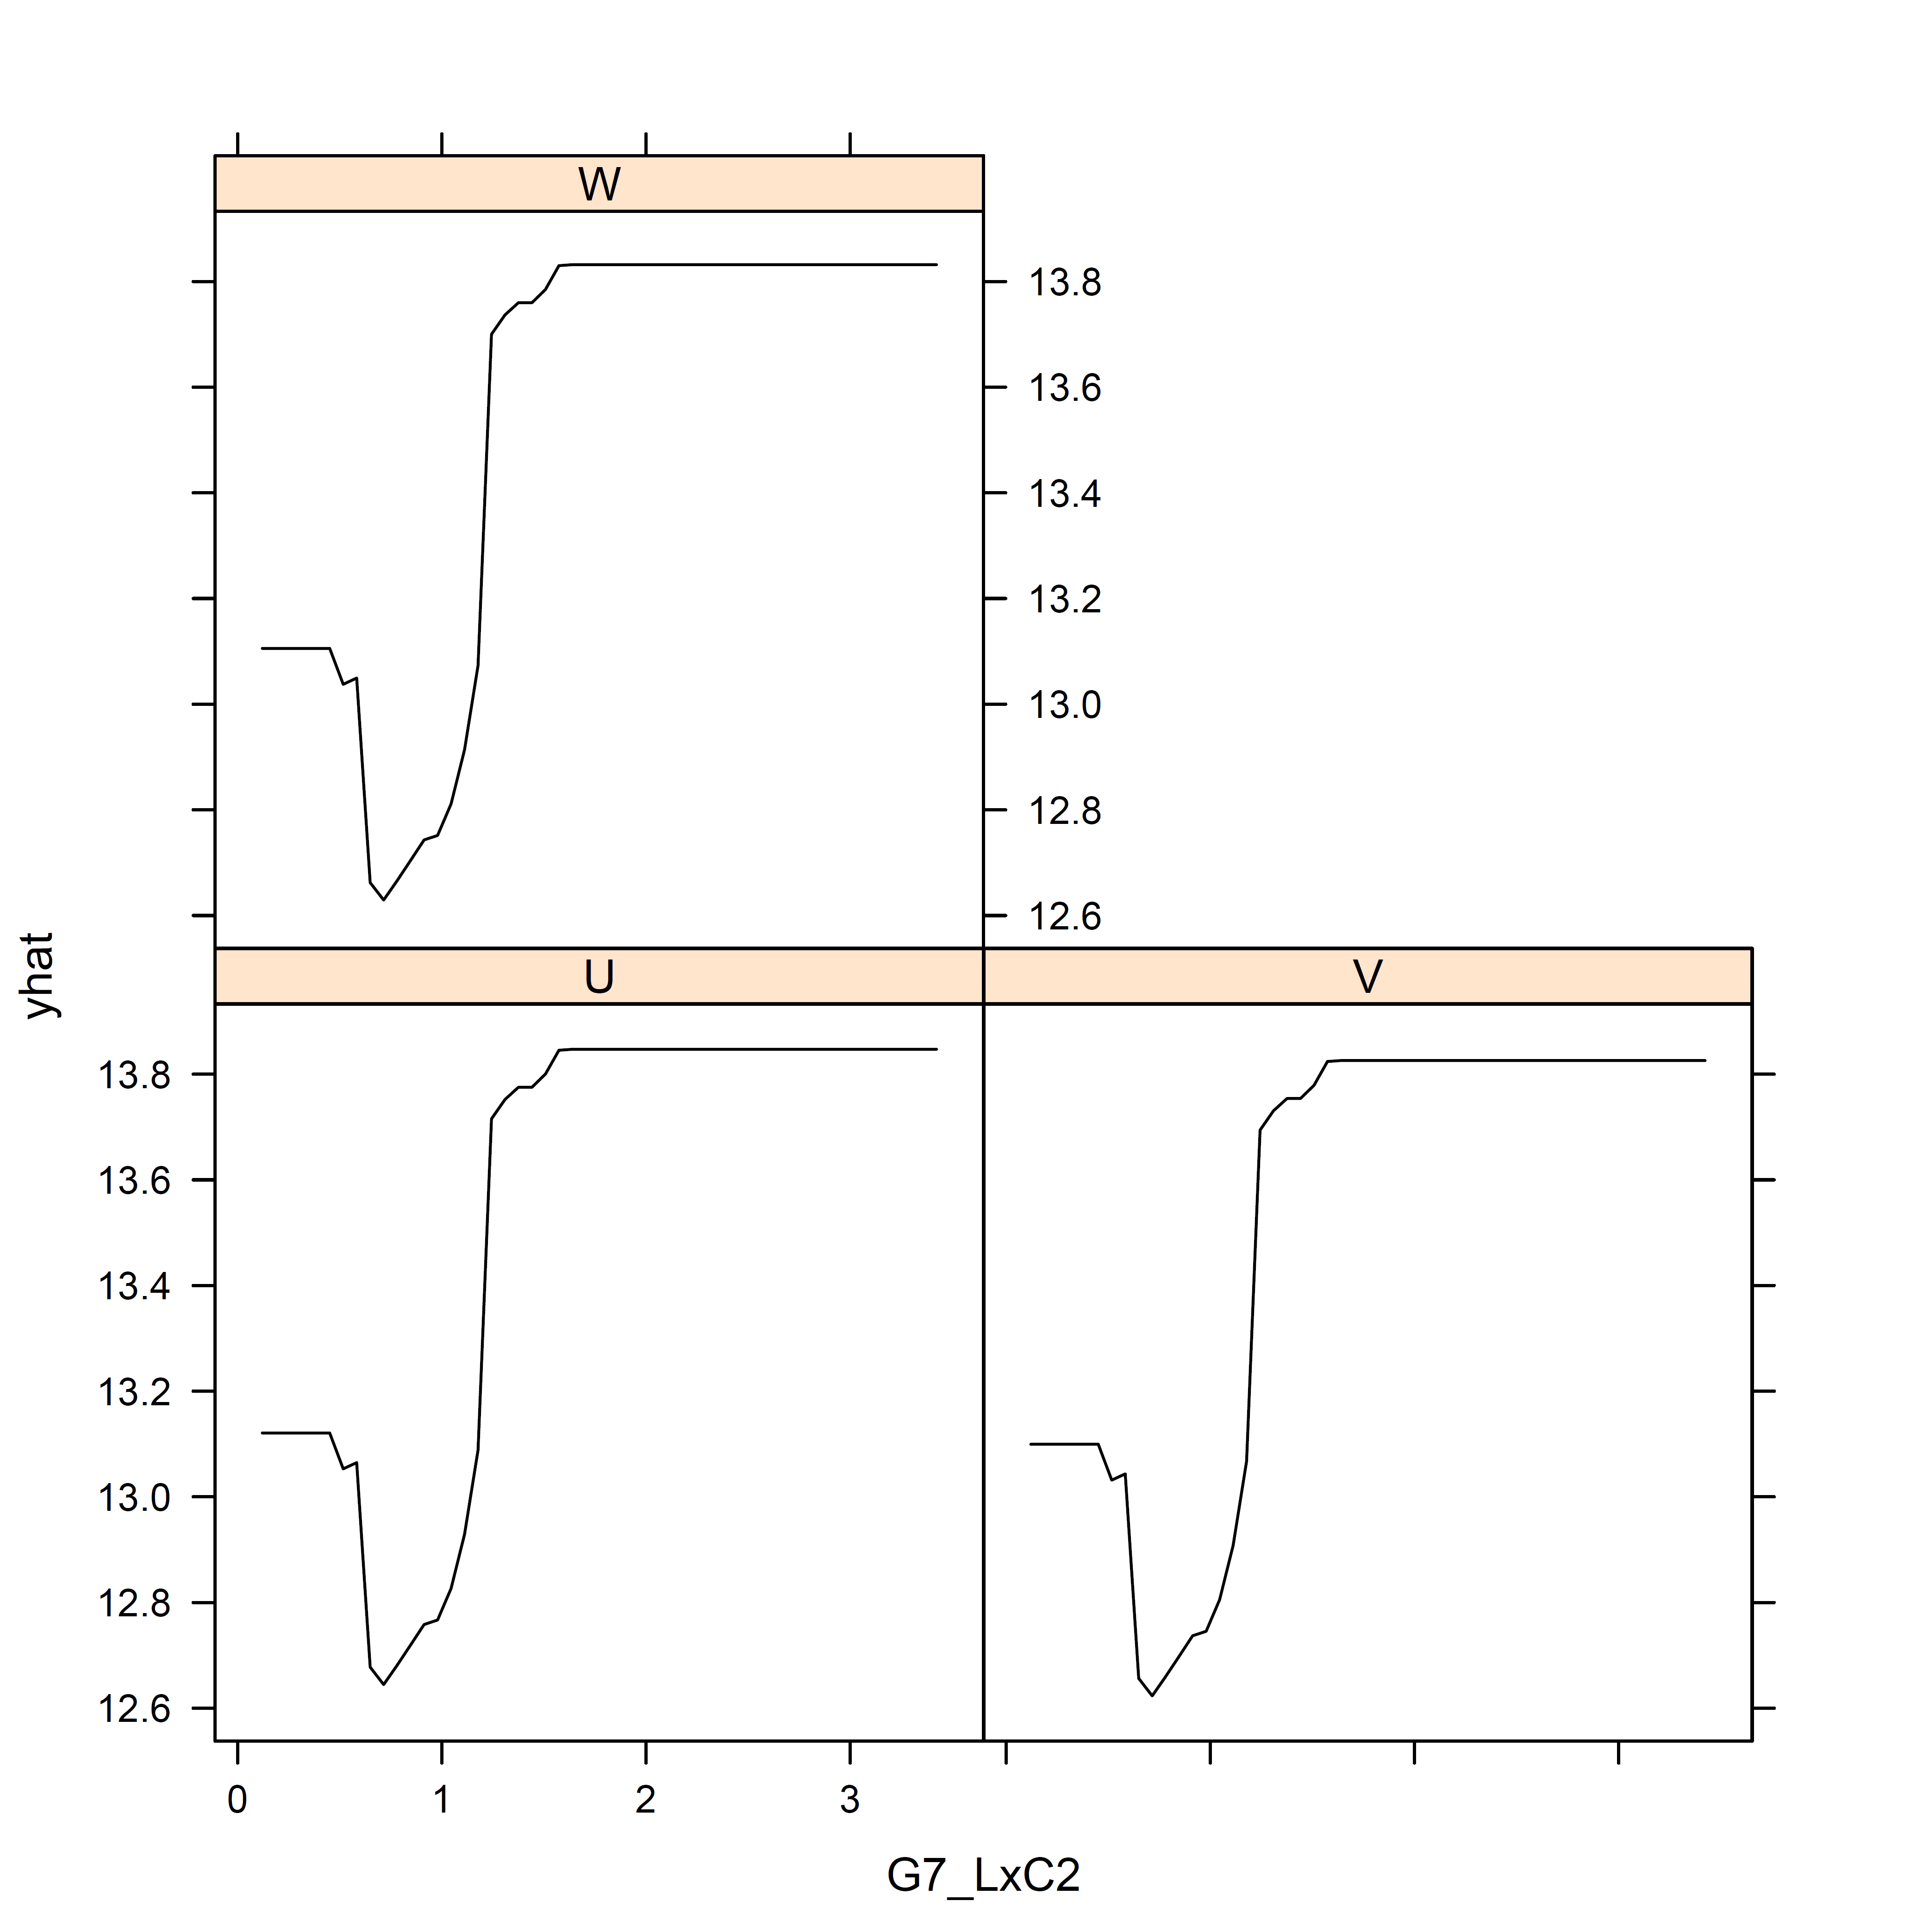
R package:
pdp

Slide 35
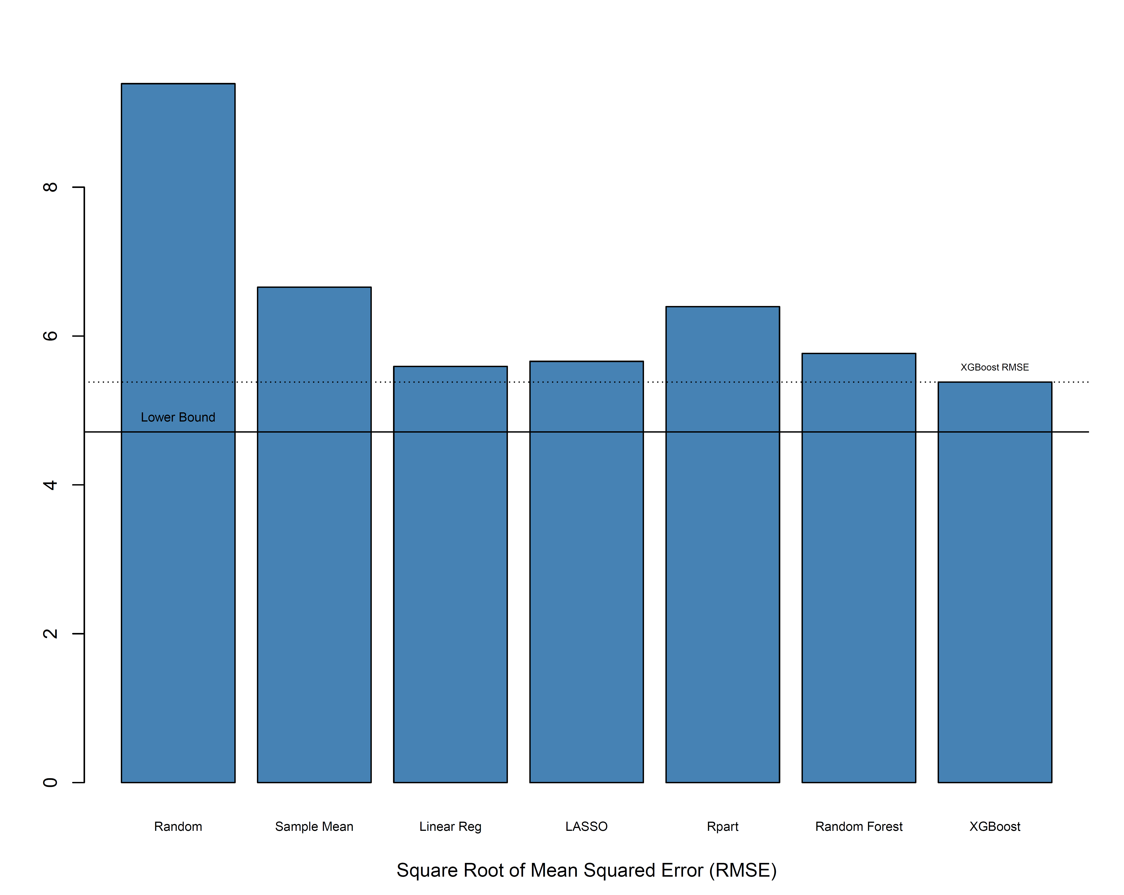

Now, how did we do?

Slide 36
What have we learned from the simulation?
Good old linear regression does a pretty good job!
Even though it misses non-linear relationships and interactions
Very good “first-order” functional approximation
Single tree methods can be quite limited in predictive performance
Can provide insight into most important predictors
“Greediness” of the algorithm means it misses a lot
Ensembles of weak learners can offer significant improvement
Randomization can help uncover relationships masked by other variables
Random Forest substantially better than single tree
Boosting can provide substantially improved predictive performance
Learning from errors is a powerful concept
But it still requires work – and isn’t a “magic bullet”

Slide 37
Application: Estimating Propensity Scores for the Receipt of Allogeneic Hematopoietic Cell Transplantation (AlloHCT) in Outcomes Research Using Claims Data: A Machine Learning Approach Vanness DJ, Preussler JM, Burns LJ, Denzen EM, Leppke SN, Majhail NS, Mupfudze T, Saber W, Silver A, Steinert P, Mau LW. Biology of Blood and Marrow Transplantation. 2018 Mar 1;24(3):S304-5.

Slide 38
Addressing Potential Confounders
Propensity scores can be used to adjust for observed confounders that affect both selection of alloHCT selection and outcomes.
Logistic regression (logit) is the standard approach to construct propensity scores.
Machine learning may offer advantages when there are many possible predictors relative to observations or when interactions and discontinuities may be important but would be difficult to pre-specify.
Our aim was to compare propensity score distributions, treatment selection residuals and stabilized inverse propensity-weighted standardized differences in covariates between propensity scores constructed using logistic regression and the xgboost machine learning algorithm.

Slide 39
Data
A cohort was constructed using Optum Clinformatics Data Mart (2004- 2014) comprising medical and pharmacy claims from a large national insurer with 12.4 - 14 million unique members each year.
Patients age ≥ 20 receiving alloHCT (n=278) or chemotherapy only (n=570) who met the following inclusion criteria were included:
≥1 inpatient claim or 2 outpatient claims within 3 months having an ICD-9 code indicating AML
≥2 months of continuous enrollment prior to the first claim with a diagnosis of AML (“diagnosis date”)
No evidence of previous treatment for AML

Slide 40
Approach
We used glm (binomial family, logistic link) in R (3.2.0) to estimate the probability of receiving alloHCT (vs. chemotherapy only) conditional on the following covariates:
Demographics: age, gender, region (Midwest, Northeast, South, West, Unknown and combinations), and year of diagnosis
Insurance: payer (commercial, Medicare, combined commercial and Medicare), product (exclusive provider organization [EPO], point of service [POS], preferred provider organization [PPO] health maintenance organization [HMO], indemnity [IND], other, and combinations
Baseline health status: Elixhauser Comorbidity Index, comorbidity indicators (hypertension, diabetes, coagulopathy, electrolyte imbalance, anemia), and time from diagnosis to chemotherapy initiation
We then used boosting (R package xgboost) with stochastic resampling and feature selection, tuned to maximize 10-fold cross-validated log-likelihood.

Slide 41
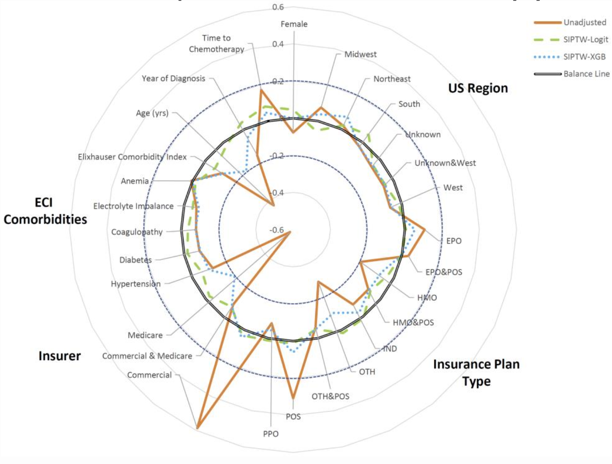
Balance Results
Stabilized inverse propensity-weighted datasets constructed using either logistic regression or xgboost each produced no covariates having an absolute standardized difference greater than 0.2, indicating that both approaches achieved acceptable covariate balance
© 2018 Dave Vanness

Slide 42
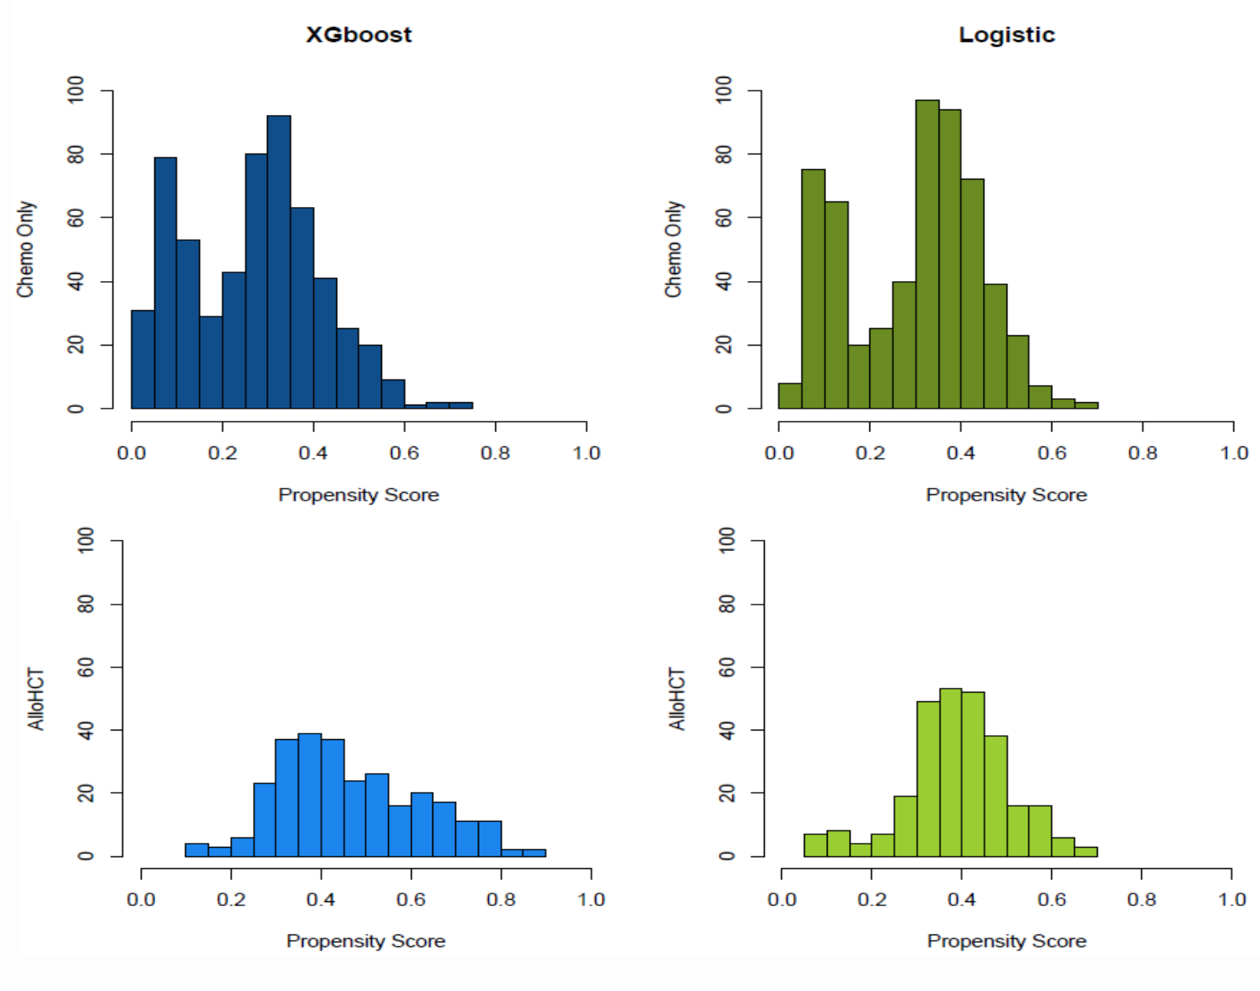
Propensity Score Distributions
Distribution of propensity scores constructed with both logistic regression and xgboost showed desirable overlap between patients receiving alloHCT and chemotherapy only.
Propensity scores constructed with xgboost, however, demonstrated a more favorably pronounced rightward shift (indicating higher likelihood of receiving alloHCT among those who received alloHCT
© 2018 Dave Vanness

Slide 43
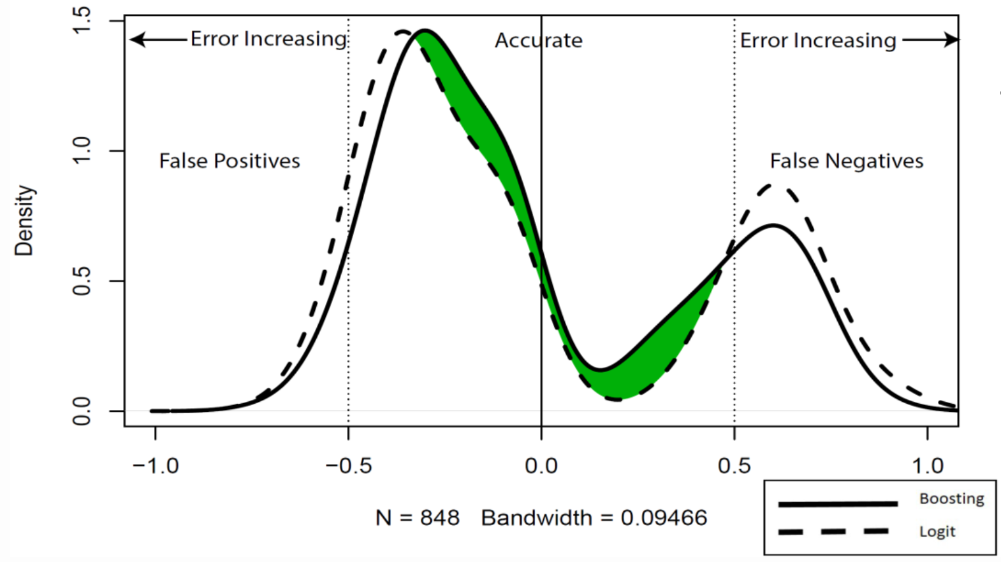
Distribution of Treatment Selection Errors
The xgboost algorithm outperformed logistic regression in terms of accurately predicting receipt of alloHCT, which shows both fewer false positives and false negatives.
© 2018 Dave Vanness

Slide 44
Recap of Learning Objectives
The Iron Law of Prediction
Excessively complex models may give better fit to the data at hand but worse predictions for outcomes not yet observed.
Penalization
Penalizing complexity can lead to models that are “right sized” for the most accurate predictions.
Cross-validation
Creating hold-out subsamples can simulate the Iron Law of Prediction using available data
Parameter Tuning
Choosing parameters of our ML algorithms to minimize cross-validation error, not to maximize fit to the observed data
Ensembles of Weak Learners
Bagging: randomly resampling the data and aggregating multiple models
Random feature selection: choosing the best predictor from a random subset (less greedy)
Boosting: fitting a sequence of models on the errors of the previous generation

Slide 45
References / Readings
Doupe P, Faghmous J, Basu S. Machine Learning for Health Services Researchers. Value in Health. 2019; 22(7):808–815
Shmueli G. To explain or to predict?. Statistical science. 2010;25(3):289-310.
Jordan MI, Mitchell TM. Machine learning: Trends, perspectives, and prospects. Science. 2015 Jul 17;349(6245):255-60.
Friedman J, Hastie T, Tibshirani R. The elements of statistical learning. New York: Springer series in statistics; 2001.
Tibshirani R. Regression shrinkage and selection via the lasso: a retrospective. Journal of the Royal Statistical Society: Series B (Statistical Methodology). 2011 Jun 1;73(3):273-82.
Zhang H, Singer BH. Recursive partitioning in the health sciences. Springer Science & Business Media; 2013 Mar 14.
Strobl C, Malley J, Tutz G. An introduction to recursive partitioning: rationale, application, and characteristics of classification and regression trees, bagging, and random forests. Psychological methods. 2009 Dec;14(4):323.
Breiman L. Random forests. Machine learning. 2001 Oct 1;45(1):5-32.
Friedman JH. Stochastic gradient boosting. Computational statistics & data analysis. 2002 Feb 28;38(4):367-78.
Adam NR, Wieder R, Ghosh D. Data science, learning, and applications to biomedical and health sciences. Annals of the New York Academy of Sciences. 2017 Jan 1;1387(1):5–11.
Rose S. Robust Machine Learning Variable Importance Analyses of Medical Conditions for Health Care Spending. Health Services Research [Internet]. [cited 2018 Sep 21];0(0). Available from: https://onlinelibrary.wiley.com/doi/abs/10.1111/1475-6773.12848
Rose S, Bergquist SL, Layton TJ. Computational health economics for identification of unprofitable health care enrollees. Biostatistics. 2017 Oct 1;18(4):682–94.
Lee Brian K., Lessler Justin, Stuart Elizabeth A. Improving propensity score weighting using machine learning. Statistics in Medicine. 2009 Dec 3;29(3):337–46.
Pirracchio R, Petersen ML, van der Laan M. Improving Propensity Score Estimators’ Robustness to Model Misspecification Using Super Learner. Am J Epidemiol. 2015 Jan 15;181(2):108–19.

